Slide 1
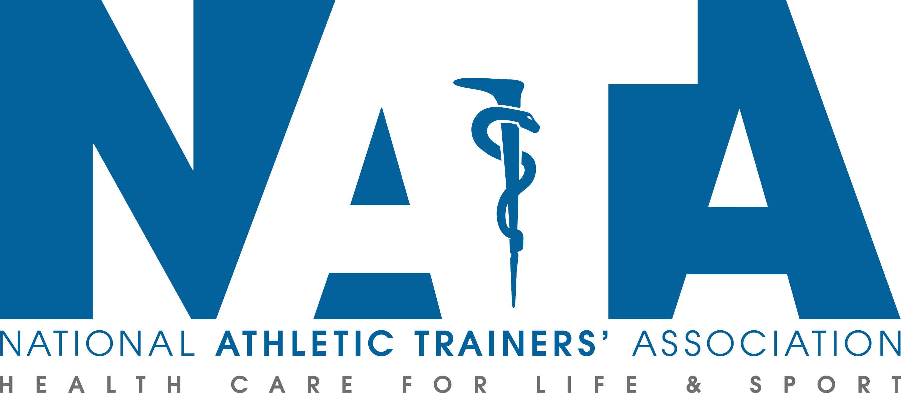
Sudden Cardiac Arrest in
Intercollegiate Athletics

Slide 2
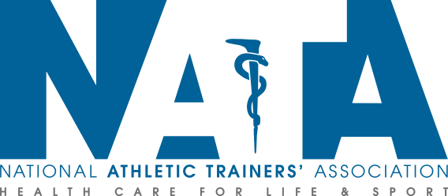
Sudden Cardiac Arrest in Intercollegiate Athletics Are you prepared ?

Slide 3
Prevalence of Sudden Cardiac Arrest
SCA affects about 1 in 44,000 NCAA Student Athletes Annually
Of the deaths from medical causes, 56% were cardiovascular-related sudden deaths
Males have a high incidence than females
Sports at a high risk include(in order) basketball, swimming, lacrosse, football, and cross country
Death rate among Afro-American athletes is 1:17,696 compared to 1 in 58,653 for Caucasian competitors
Division I male basketball players, the rate of SCD was 1:3100 per year

Slide 4
Recognition of SCA
SCA should be suspected in any athlete who is collapsed and unresponsive
SCA should be suspected in any non-traumatic collapse
Brief seizure-like activity is common after collapse from SCA
Seizure = SCA until proven otherwise
Occasional gasping is not normal breathing… think SCA

Slide 5
Common Causes of SCA
Ventricular fibrillation occurs leading to improper heart rhythms
Conditions seen include:
Hypertrophic Cardiomyopathy
Congenital Abnormalities of Coronary Arteries

Slide 6
Prevention of SCA Screening
Student-athletes are required to have a pre-participation physical examination.
The PPE includes: Insert institutional screening policy here if applicable
History (chest pain or passing out with exercise)
Physical exam (blood pressure, heart sounds)

Slide 7
Prevention of SCA Emergency Preparation
Emergency Action Plan
Essential elements of an emergency action plan include:
(insert specific institutional plans for all of the following)
Methods of communication
Personnel requiring CPR and AED training
Locations of AEDs for early defibrillation
Practice and review of the response plan

Slide 8
Emergency Planning
Written Emergency Action Plan for SCA
Emergency communication system
Trained responders in CPR/AED
AED locations – all staff awareness
Access to early defibrillation (<3-5 min collapse to shock)
Practice and review of the response plan at least annually
Integrate AEDS into local EMS system

Slide 9
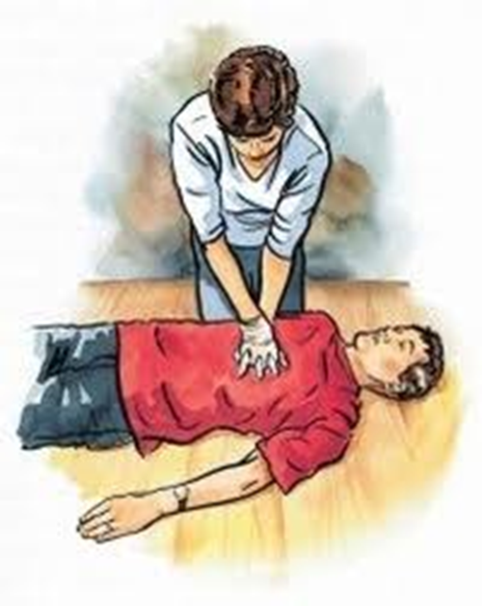
Management of SCA
Chain of Survival
Early CPR
Prompt AED usage

Slide 10
Chain of Survival
Early Recognition
Early CPR
Early AED
Improved Survival

Slide 11
Early CPR
CPR can double or triple the chance of survival
< 1/3 of SCA victims receive bystander CPR
2010 AHA guidelines
Hands-only CPR
Chest compressions
Push hard, push fast (100 per minute)
HCP 2 person CPR

Slide 12
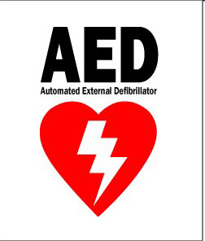
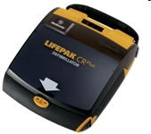
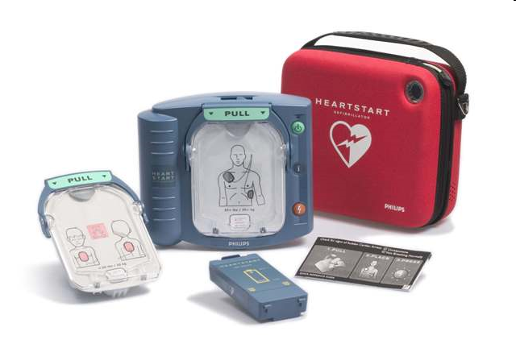
Availability of AEDs
The single greatest factor affecting survival is the time from cardiac arrest to defibrillation (shock)
AEDs improve survival through early defibrillation
Survival rate decreases by 10 % for ever minute an AED is not being used

Slide 13
Management of SCA The Collapsed and Unresponsive Athlete
Suspect SCA in any collapsed and unresponsive athlete
An AED should be applied as soon as possible for rhythm analysis and shock if indicated

Slide 14
Sequential Steps in SCA
Recognize SCA
Call for help / Call 9-1-1
Begin chest compressions (CPR)
Send bystander to retrieve AED
Apply and use the AED as soon as possible
Continue CPR until EMS arrives

Slide 15
References
2013-14 NCAA Sport Medicine Handbook
K. Harmon, I. Asif, D. Klossner and J. Drezner “Incidence of Sudden Cardiac Death in National Collegiate Athletic Association Athletes”. Circulation. 2011;123:1594-1600; originally published online April 4, 2011
National Athletic Trainers' Association Position Statement: Preventing Sudden Death in Sports. JAT. 2012 Jan-Feb 47(1) 96-118
Journal of American Cardiology; Vol 67; Issue 25, June 2016 DOI:10:1016/j.jacc.2016.03.527
Revised March 2017

