Slide 1


Notes:
Include State/District Association Logo

Slide 2

About At Your Own Risk
A public awareness campaign developed by NATA.
Mission: The mission of At Your Own Risk is to educate, provide resources and equip the public to act and advocate for safety in work, life and sport.

Slide 3
Goals of At Your Own Risk
Create ambassadors for the athletic training profession and for causes championed by athletic trainers
Reinforce the athletic trainer’s position as an authority in athlete safety
Clearly define how key stakeholders can get involved to impact change and improve safety

Slide 4
Key Stakeholders
Primary Focus: Secondary Schools
  Parents
  Student-athletes
  Administrators
  Legislators
This campaign will expand to include key stakeholders in occupational health, military and collegiate level.

Slide 5
The Issue of Risk
Risk is a common issue that all stakeholders face. Risk of:
  Injury
  Lawsuit
  Lost Profit
  Etc.
Athletic trainers play a sustainable role in risk mitigation. Athletic trainers can help prevent injuries, reduce liability and improve productivity. Athletic trainers offer a safer approach.
Notes:
At Your Own Risk was created to educate key stakeholder about this common issue and create ambassadors who will champion for change in work, life and sport.

Slide 6
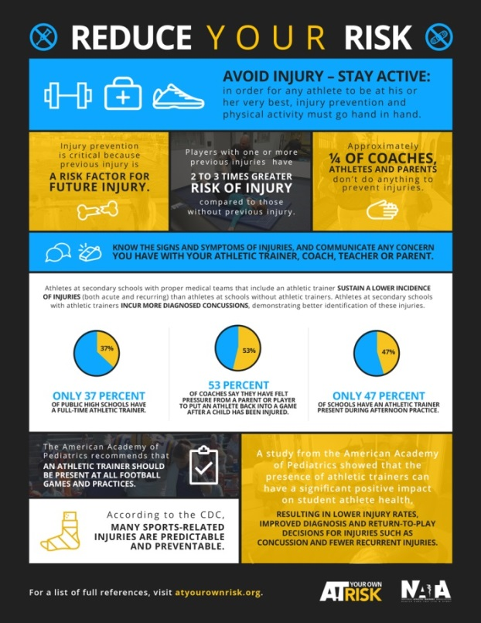
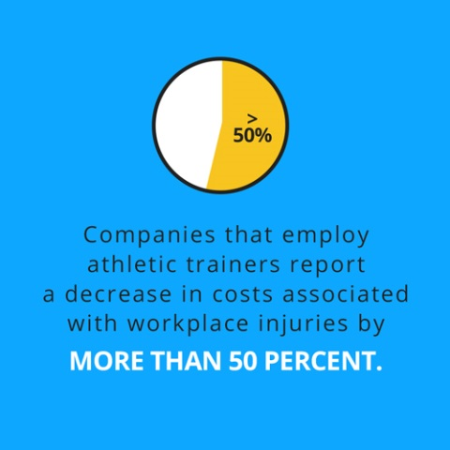
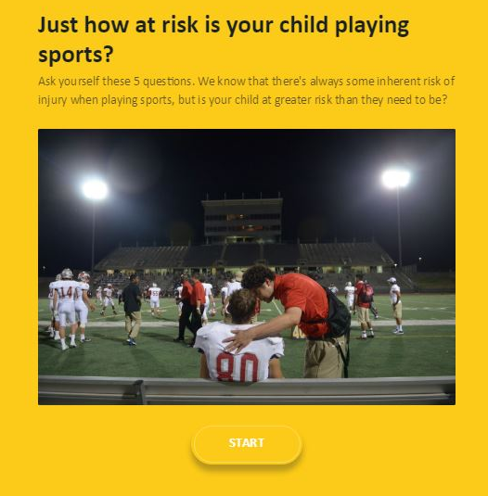
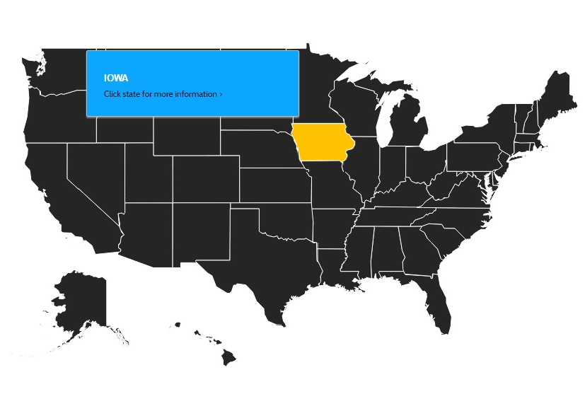
Engaging the Stakeholder
Interactive Risk Assessment Quiz
Infographics
Interactive Map
Notes:
This campaign uses a variety of methods to engage and educate the stakeholders. Some of the resources include an interactive quiz to assess risk; infographics and shareable social images; an interactive map that features information about state policies, regulation and employment of athletic trainers.

Slide 7
Notes:
Will feature At Your Own Risk PSA Video.

Slide 8
[State/District Association Details]
(Include information about how your state or district association is adopting this campaign and how your members can help).
Notes:
At Your Own Risk was created to educate key stakeholder about this common issue and create ambassadors who will champion for change in work, life and sport.

