Slide 1
Athletic Trainers
(Presenter Name and Credentials Here)

Slide 2
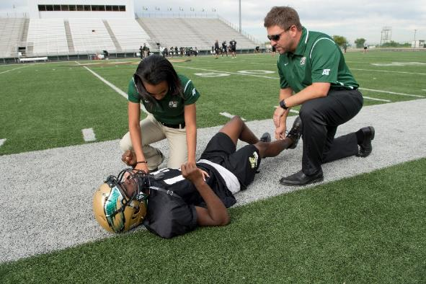
Who are Athletic Trainers?
Notes:
Official definition of an athletic trainer (feel free to paraphrase): Athletic trainers (ATs) are Healthcare professionals who render service or treatment, under the direction of or in collaboration with a physician, in accordance with their education and training and the states' statutes, rules and regulations. As a part of the healthcare team, services provided by ATs include injury and illness prevention, wellness promotion and education, emergent care, examination and clinical diagnosis, therapeutic intervention and rehabilitation of injuries and medical conditions.

Slide 3
Who are Athletic Trainers?
70% of athletic trainers (ATs) have a master’s degree or higher
To be certified (ATC), a candidate must:
Graduate from an accredited athletic training program
Pass the Board of Certification (BOC) exam

Slide 4
Who are Athletic Trainers?
Regulated in 49 states and the District of Columbia
Efforts continue to add licensure in CA

Slide 5
Athletic Trainers vs Personal Trainers

Slide 6
Athletic Trainers vs Personal Trainers
Athletic Trainers
High qualified, multi-skilled health care professionals who collaborate with physicians to provide medical services.
Personal Trainers
Non-medical professionals who develop, monitor and change an individual’s fitness program to help them reach their goals.

Slide 7
Athletic Trainers vs Personal Trainers
Athletic Trainers
Must have a degree from an accredited athletic training program.
Must pass a certification exam.
Personal Trainers
May or may not have advanced degree in health sciences.
May or may not need to take a certification exam.

Slide 8
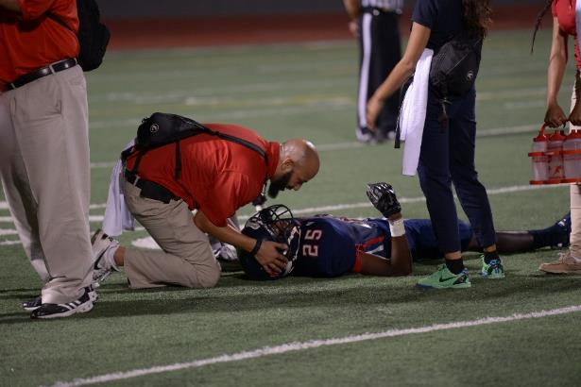
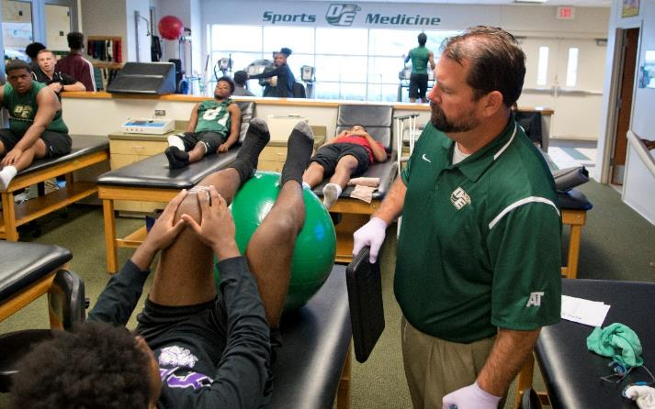
What Services Do Athletic Trainers Provide?

Slide 9
What Services do Athletic Trainers Provide?
https://vimeo.com/172768759

Slide 10
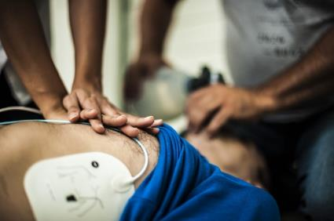
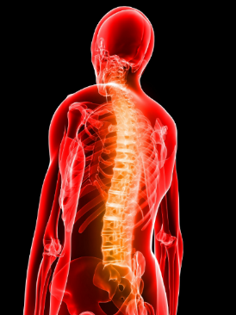
What Injuries/Illnesses do Athletic Trainers Treat?
Notes:
The slide shows asthma, heat stroke, sudden cardiac arrest, a neck/spinal injury and concussion. Other Injuries/Illnesses you can mention that ATs treat include diabetic emergencies and sickle cell crisis.

Slide 11
Athletic Trainers Reduce Risk
Preventative Services
Clinical Examination and Diagnosis
Therapeutic Intervention
Emergency Care
Rehabilitation of Injuries and Medical Conditions

Slide 12
Athletic Trainers Reduce Risk
Also on AtYourOwnRisk.org
Resources Including:
Injury Statistics
Detailed Infographics
Case Studies on the Efficacy of ATs
Risk Assessment Quizzes
Notes:
If your audience includes either school administrators (ADs or Principals), Parents, Student-Athletes, Industrial Employers or Legislators, you can tell them that there are sections on this site developed for them and their unique needs.

Slide 13
THANK YOU!

