Slide 1
Zotero
Laura Ann Zdziarski, LAT, ATC
zdziala@ortho.ufl.edu

Slide 2
What is Zotero?
An online personal research assistant
Store articles, books, newspapers, multimedia, etc
Organize your documents into different collections
Share your folders with your collaborators
Automatically cite sources within your word document
Change citation styles EASILY
Generate a bibliography/reference list
Makes changes as you edit your document
Zotero is a production of the Roy Rosenzweig Center for History and New Media at George Mason University and the Corporation for Digital Scholarship. It has been generously funded by the United States Institute of Museum and Library Services, the Andrew W. Mellon Foundation, and the Alfred P. Sloan Foundation.

Slide 3
Zotero Download

Slide 4
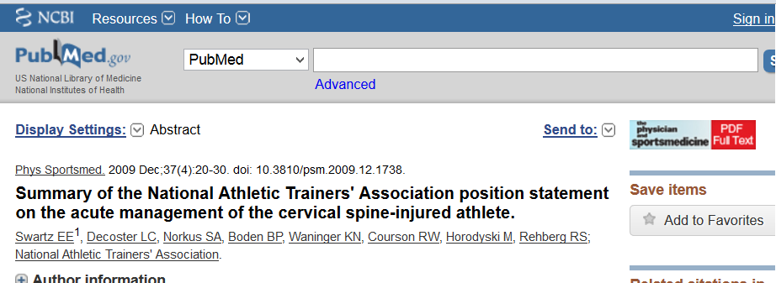
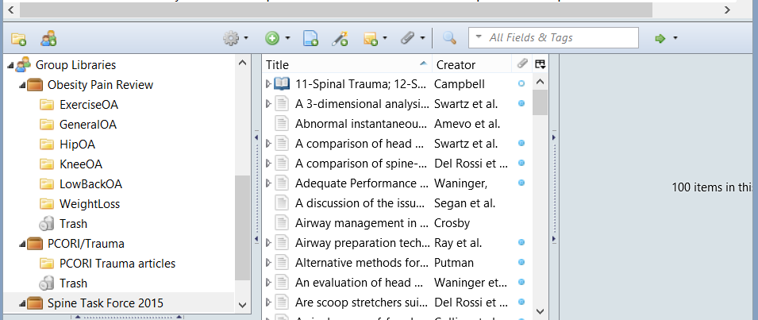
Adding Documents to Your Library
Correct Browser??
Find the article/document
Confirm you have access to the PDF
Click the Zotero Icon
Manual Entry

Slide 5
Accessing or Reading Documents
Access your library via the “Z” icon in upper right corner of browser
Double click on the article/document
The PDF or hyperlinked document will load

Slide 6
QUESTIONS???
Laura Ann Zdziarski zdziala@ortho.ufl.edu

Slide 7
Zotero & Word
FIRST you have to download the plug-in
Before you start writing/working on your word document (every time) open your web browser
Once ready to add an in text citation locate your zotero menu
Select the “insert citation” icon

Slide 8
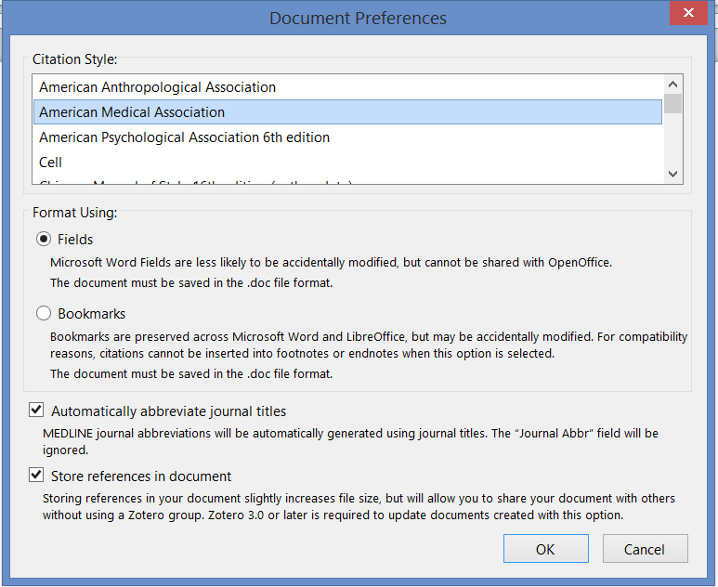
Zotero & Word
This dialogue box will appear the first time you attempt to make an in text citation
Select the citation style format
The style you want is not in the list…What do you do?
There are hundreds of styles available online!

Slide 9
Zotero & Word
After you have set the document preferences, the zotero bar will appear
From here you can type the name of the paper(s) or author(s) you wish to cite
Once you are ready to insert your bibliography, select the “insert bibliography” icon in the zotero menu

Slide 10
Zotero Symbols
Insert In-Text Citation
Edit In-Text Citation
Insert Bibliography
Edit Bibliography
Zotero Refresh
Set Doc Preferences

Slide 11
Questions???
Laura Ann Zdziarski zdziala@ortho.ufl.edu

Slide 12
Key Points
Must use Correct Browser to add documents to library
Firefox, Safari, or Chrome
If you are using the zotero standalone, you must also download the “plug-in” for your internet browser to be able to add documents into the library
When adding documents to the library, if you have multiple folders, the document will be saved in the last folder you were working in by default
Make sure you have installed the plug-in for Microsoft Word
Your browser must be running/open when adding citations to your word document (while your writing)

Slide 13
Helpful Resources
Zotero Download
https://www.zotero.org/download/
Microsoft Word Plug-in download
https://www.zotero.org/support/word_processor_plugin_installation
Citation Styles: Zotero Repository
https://www.zotero.org/styles
Quick Start Guide to Zotero
https://www.zotero.org/support/quick_start_guide
How to add Documents to Your Library
https://www.zotero.org/support/getting_stuff_into_your_library

