Slide 1
WELCOME!!
Celebrating Women In Athletic Training

Slide 2
A Special Thank You to the following who worked so hard to make this a special day:
Jim Thornton – NATA President
Kathy Dieringer – District 6 Director; former WATC
Pat Aronson – District 3 Director; former WATC
Tim Weston – District 1 Director
Michael Goldenberg – District 2 Director
Tamesha Logan – Director of Marketing and Public Relations
Kandy Cefoldo – Senior Board Relations Coordinator

Slide 3
A Special Thank You to the organizing committee:
Katie Grove – Task Force and WATC chair
Gretchen Schlabach – D4 Task Force & D4 WATC
Cheri Drysdale- Orndorff – D2 WATC
Margie King – D1Task Force & WATC Chair
And technical assistance provided by:
Jessica Rager
Brian Duclos

Slide 7
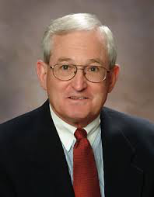
Celebrating Women In Athletic Training
Thank You
KENT FALB
NATA Past President
At the time the Task Force was being formed Ken
was the District 4 Director. He presented the proposal to the NATA Board of Directors that Katie Grove(District 4 member) brought forward.
Ken was the one tasked with answering the questions from the BOD. He was ultimately the person who got it approved in early 1995.

Slide 8
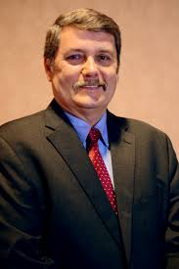
Celebrating Women In Athletic Training
Thank You
R.T. FLOYDD
NATA Staff Liaison
A special thanks to R.T. for being the only male
BOD member to draw the short straw to be the
first and only male liaison to WATC.
Thank you for your IT and organizational skills
as well as your ever present support for all
we set out to accomplish.

Slide 10
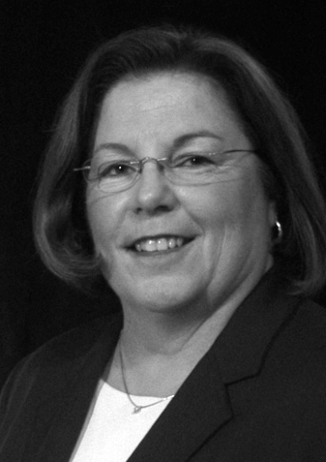
Celebrating Women In Athletic Training
Thank You
CYNTHIA “SAM” BOOTH
BOD Liaison
"Sam" was our second BOD
Liaison beginning in 1996. She was funny,
insightful, smart, and had a way of making
suggestions that made us think we
were so smart. Thanks for that one Sam.
Ultimately she gave us her all and
supported us in all of our endeavors

Slide 12
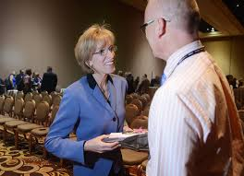
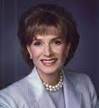
Celebrating Women In Athletic Training
Thank You
EVE BECKER DOYLE
NATA Executive Director Eve was the number 1 supporter of the Task Force. She understood the need for women to have a place to develop leadership skills to become an inclusive part of the Athletic Training Profession. When the question arose about whether we should have a man on the Task Force Eve was the first one to say "no".
I don't know whether she remembers this, but to this day, I am so thankful that she understood and voiced this because my voice (Katie G) was not very loud.

Slide 13
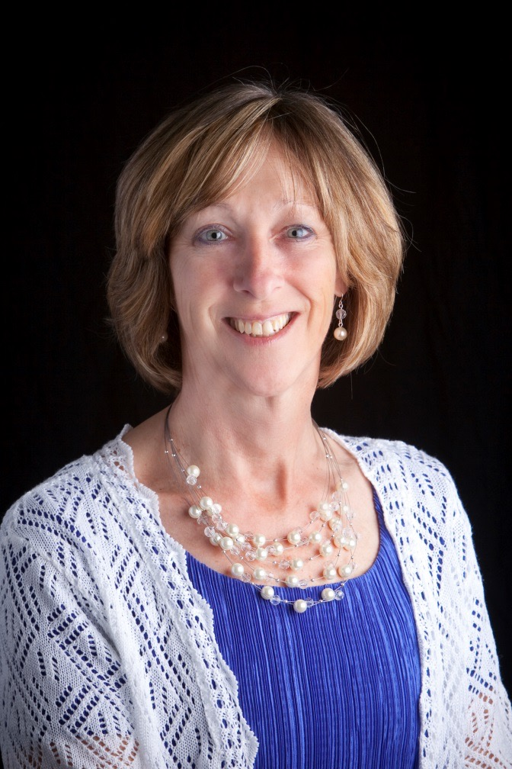
Marjorie A. King
NATA Member Since 1978
WATC Task Force Member
1995 - 1996
Chair~ Women in Athletic Training 2000 - 2008

Slide 14
Marjorie A. King
EDUCATION
BS in Medical Technology from University of New Hampshire
BS in Physical Therapy from Simmons College
MS in Exercise Science from University of Massachusetts, Amherst
PhD in Sports Medicine from University of Virginia, Charlottesville
CURRENTLY
Director of Athletic Training Graduate Education at Plymouth State University

Slide 15
Marjorie A. King
2012 - Inducted into the NATA Hall of Fame
2012 – Inducted as Fellow in the American College of Sports Medicine
2012 - EATA Renamed Research to Reality annual lecture series
“Marjorie A. King Research to Reality” annual presentation
2006 - New Hampshire Most Distinguished Athletic Trainer of the Year
2005 - NATA Most Distinguished Athletic Trainer Award
2004 - NATA Service Award
2002 - EATA Frank George Post-Graduate Scholarship Grant
In recognition of exceptional leadership in Athletic Training and demonstrated by distinguished academics and research; 1st recipient
2001-2008 - WATC Committee Chairperson
1996 - 1st Female to receive Cramer Award
For providing leadership and advancing the profession
1995 - District 1 rep on WATC task force
1993 - 1st Female elect President of EATA

Slide 16
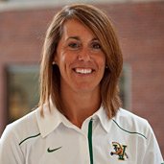
ALLISON SHEPHERD
WATC Member District 10
2003 - 2006

Slide 17
Allison Shepherd
EDUCATION
BS from Central Connecticut State University
MA from Whittier College
CURRENTLY
Head Athletic Trainer for the University Of Vermont

Slide 18
BEVERLY SWEET
NATA Member Since
1975
WATC Member District 8
1995 - 2001

Slide 19
BEVERLY SWEET
EDUCATION
BA California State University, Long Beach
MA Emphasis Athletic Training California State University, Long Beach
CERTIFICATIONS
California State Standard Teaching Credential - Community College,
American Red Cross – Instructor Certification for First Aid, CPR, AED
CURRENTLY
Part-time instructor Cerritos College

Slide 20
BEVERLY SWEET
2015 - Inducted into Cerritos College
Hall of Fame as Distinguished Classified
2012 - Crisis Management Presentation for Cerritos College Management
2012 - Developed Safety Response Cards for Campus
2003 - Far West Athletic Trainers’ Association Special Service Award for California
Cerritos College Disaster Plan and Educational Master Plan Task Forces; Negotiations Committee and Team; Safety Committee
International Educational 3-Day Program for Osaka-Jikei College, Osaka, Japan, 2002- current (Co-Chair 2000-2013)
Developed the Athletic Trainer Aide Educational Program, International program with Osaka
Supervising Athletic Trainer for students in Athletic Training, 1980-2013

Slide 21
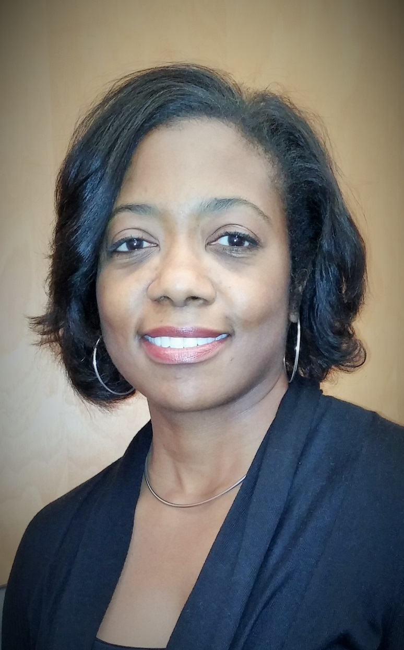
CARRIE GRAHAM
NATA Member Since 1993
WATC Member
District 10
2000-2003
WATC Member District 1
2006 - 2008

Slide 22
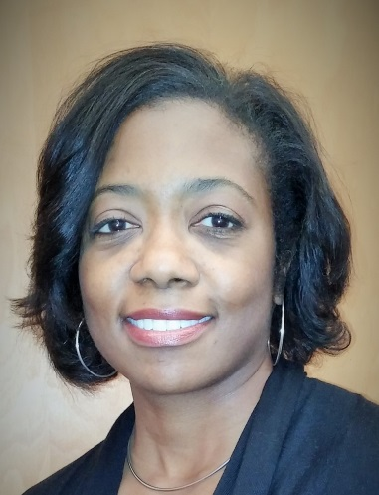
CARRIE GRAHAM
EDUCATION
BA Sports Medicine, Catawba College, Salisbury, NC
MA Health, Physical Education, and Recreation, Western Michigan University
CURRENTLY
Assistant Professor – Exercise Science/Athletic Training Catawba College, Salisbury, NC

Slide 23
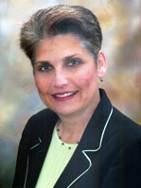
CATHY POERNER SUPAK
NATA Member Since 1981
WATC Member District 6
2003 - 2006

Slide 24
CATHY POERNER SUPAK
EDUCATION
BSEd Athletic Training, Texas State University
CERTIFICATIONS
Texas Teacher’s Certification in Secondary Education-Political Science and Physical Education
CURRENTLY
Outreach Athletic Trainer at Clear Brook High School for Houston Methodist St. John, Sports Medicine & Orthopedics

Slide 25
CATHY POERNER SUPAK
2015 SWATA Hall of Fame
2014 SWATA Most Distinguished
2014 Greater Houston Athletic Trainer Society’s Hall of Fame 2013 Appointment by TX Governor Perry to the State’s Advisory Board of Athletic Trainers
2007 Chair of Texas State Athletic Trainers’ Association (first female chair)
2004 NATA Service Award

Slide 26
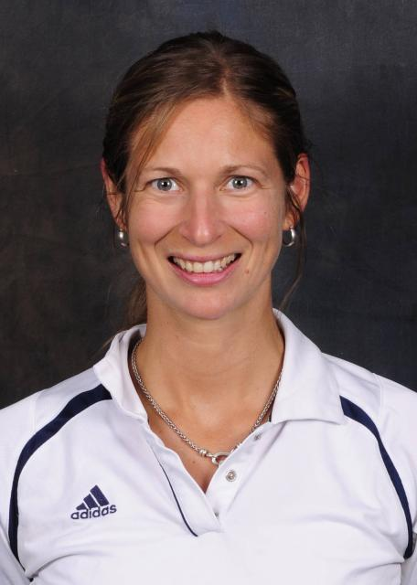
CHERI (DRYSDALE) ORNDORF
NATA Member Since 1998
WATC Member
District 2
2005 - 2008

Slide 27
CHERI (DRYDALE) ORNDORF
EDUCATION
BS Health Sciences/Athletic Training, Lock Haven University
MEd Health Education, Penn State University
CERFICATIONS
Sound Assisted Soft Tissue Mobilization Technique Certified
Red Cord Level 1 & 2 Certified
Reiki 1 & 2 Certified
CURRENTLY
Clinical Rehab Specialist for Bucknell University

Slide 28
CHERI (DRYSDALE) ORNDORF
2013-Present – Head Athletic Trainer for US Women’s Lacrosse Senior National Team (will be competing in World Cup in England 2017)
2011 –Athletic Trainer for US Women’s Lacrosse U19 Team (won World Cup in Germany
2007-2010- Served as Chair for Women in Athletic Training Tennis Tournament Committee to benefit Susan G. Komen
2006-2008- Presenter at Annual Convention for NATA on Muscle Energy
2005-2008 – NATA District 2 Chair and NJ State Chair, Women in Athletic Training Committee
1999 and 2007 – Volunteered at US Olympic Training Centers (Chula Vista and Colorado)

Slide 29
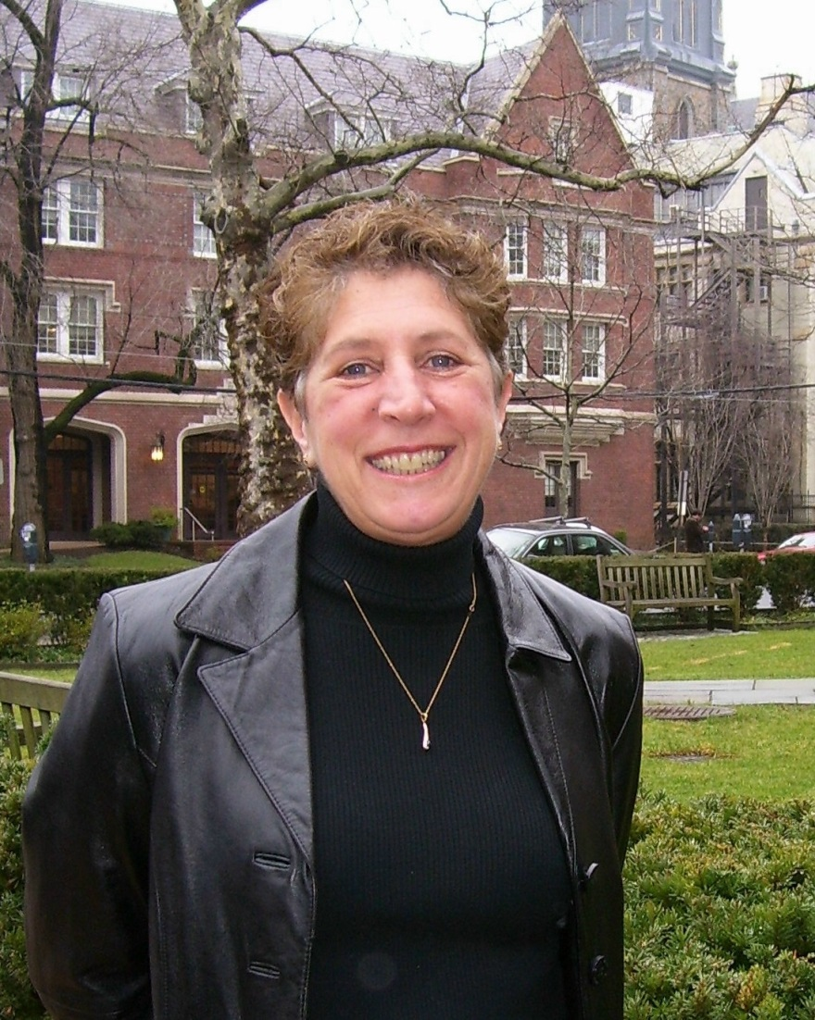
DAPHNE BENAS
NATA Member Since
1973
WATC Member District 1
2001 - 2003

Slide 30
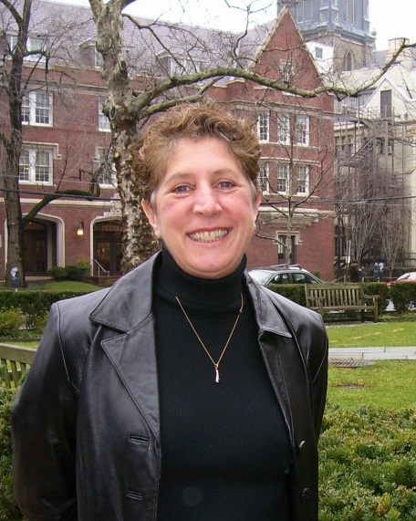
DAPHNE BENAS
EDUCATION
BS - Physical Therapy, University of Connecticut
MS – Orthopedic Physical Therapy, Quinnipiac University
CERTIFICATION/LICENSE
Licensed Physical Therapist
CURRENTLY
Assistant Athletic Trainer Yale University

Slide 31
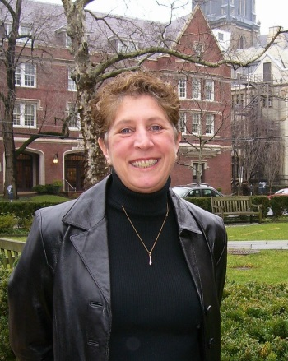
DAPHNE BENAS
Glamour Magazine Top 10 Career Woman
First woman Head Athletic Trainer of a university with a Div 1 Football program
College Athletic Trainer of the year from CATS
Member of the organizational committee for the medical coverage of the Special Olympics World games
First woman athletic trainer on the NCAA’s Competitive Safeguards Committee
On the board of the NATA Research and Education Foundation

Slide 32
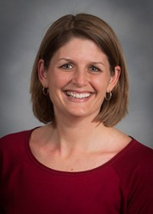
DEBBIE BRADNEY
NATA Member Since
1993
WATC Member District 3
2005 - 2007

Slide 33
DEBBIE BRADNEY
EDUCATION
BS – Ohio Wesleyan University
MS – Ohio University
DPE – Springfield College
CERTIFICATION
ACSM Certified Exercise Physiologist
CURRENTLY
Department Chair, Athletic Training

Slide 34
DEBBIE BRADNEY
2012 VATA AT Educator of the Year
CAATE site visitor and Annual Report Review Committee
BOC exam question reviewer
BOC home study reviewer
Department Chairperson, Athletic Training at Lynchburg College

Slide 35
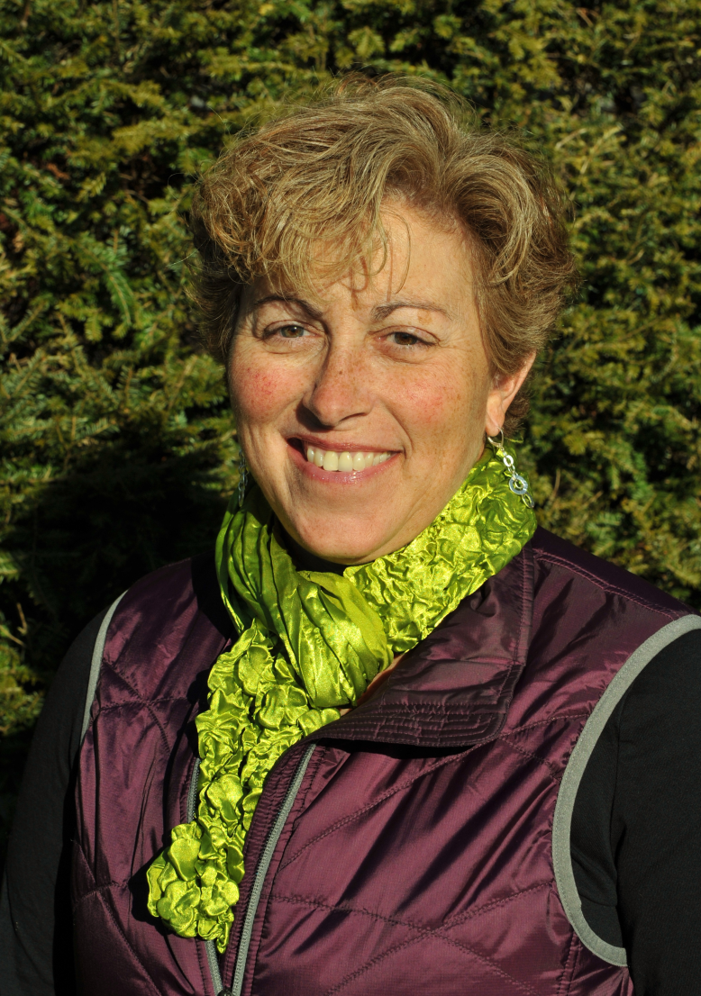
DENISE ALOSA
NATA Member Since 1985
WATC Member District 1
2003 – 2006

Slide 36
DENISE ALOSA
EDUCATION
BS - University of Vermont in Education and Athletic Training Education Program, 1985
MS - University of New Hampshire in Exercise Science, 1993
CURRENTLY
Athletic Trainer: Full-Time South Burlington High School, South Burlington, VT
Adjunct Professor: University of Vermont; Athletic Training Education Program

Slide 37
DENISE ALOSA
NATA Service Award
Henry Schein/MBM Scholastic Athletic Trainers Award, EATA
Roger T. Bryant Distinguished Athletic Trainer Award
Key Achievement Award, Community Service to Vermont City Marathon

Slide 38
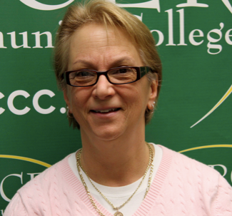
ELISA CAMILLONE
NATA Member Since 1978
WATC Member District 2
2002-2005

Slide 39
ELISA CAMILLONE
PICTURE
EDUCATION
BS – Montclair State College
MS – Trenton State College
CURRENTLY
Athletic Trainer/ Associate Director of Athletics at Mercer Community College

Slide 40
ELISA CAMILLONE
2012 Hall of Fame ATSNJ
2012 NATA CUAT Community College Head Athletic Trainer of the Year
2007-present Member of the Athletic Trainers Advisory Committee to the Board of Medical Examiners
2003 ATSNJ Distinguished Service Award ATSNJ
1991-1993 President ( Athletic Trainer Society of NJ )
College President Leadership Award
NATA service Award

Slide 41
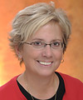
GAIL PARR
NATA Member Since 1985
WATC Member District 3
1995 - 1997

Slide 42
GAIL PARR
EDUCATION
BS Towson University
MS University of Delaware
PhD University of Maryland
CURRENTLY
Professor, Department of Kinesiology, Towson University

Slide 43
GAIL PARR
2010 Maryland Athletic Trainers Association Hall of Fame
2006 The Dan Libera Service Award for Outstanding
Contribution to the National Athletic Trainers Board of Certification
Chairperson, Examination Development Committee, Written Simulation Component, Certification Examination, National Athletic Trainers Association Board of Certification, February 2004- February 2006.
Member, Examination Development Committee, Written Simulation Component, Certification Examination, National Athletic Trainers Association Board of Certification, December 1994 – February 2004.

Slide 44
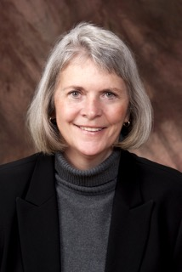
GRETCHEN SCHLABACH
NATA Member Since 1975
WATC Member
District 4
1995 - 2002

Slide 45
GRETCHEN SCHLABACH
EDUCATION
BS Physical Education, Teacher Certification, Ithaca College
MS Athletic Training, Indiana University
PhD Exercise Physiology, University of Maryland
CURRENTLY
Retired, Northern Illinois University

Slide 46
GRETCHEN SCHLABACH
2015 Chair – Committee on Professional Ethics
(COPE) Professional Responsibility Work Group
2014 Professor Emerita (pending), Athletic Training
Program, Northern Illinois University
2013 Illinois – Dedicated Service Award
2009 GLATA – Outstanding Educator Award
2008 GLATA – Service Award
2008 Professional Ethics in Athletic Training– Published
First Text Book
2006-2012 Chair – COPE
2002 – Twenty-five year service award
2000 – NATA Most Distinguished Athletic Trainer Award

Slide 47
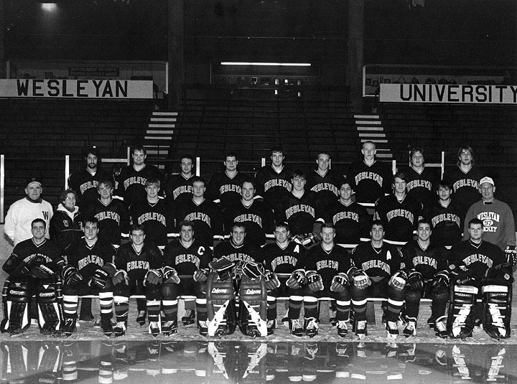
JANICE DESI
NATA Member Since
1978
WATC Member District 1
2000 - 2001

Slide 48
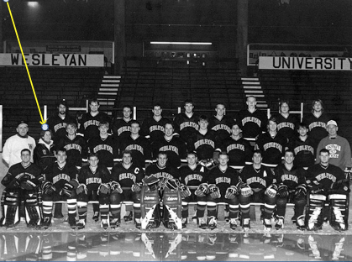
JANICE DESI
EDUCATION
BS Skidmore, Physical Education
MS Montana State University, Sports Medicine
MS Quinnipiac University. Physician Assistant
CURRENTLY
Orthopedic Physician Assistant for Middlesex Orthopedic Surgeons, Middletown, CT

Slide 49
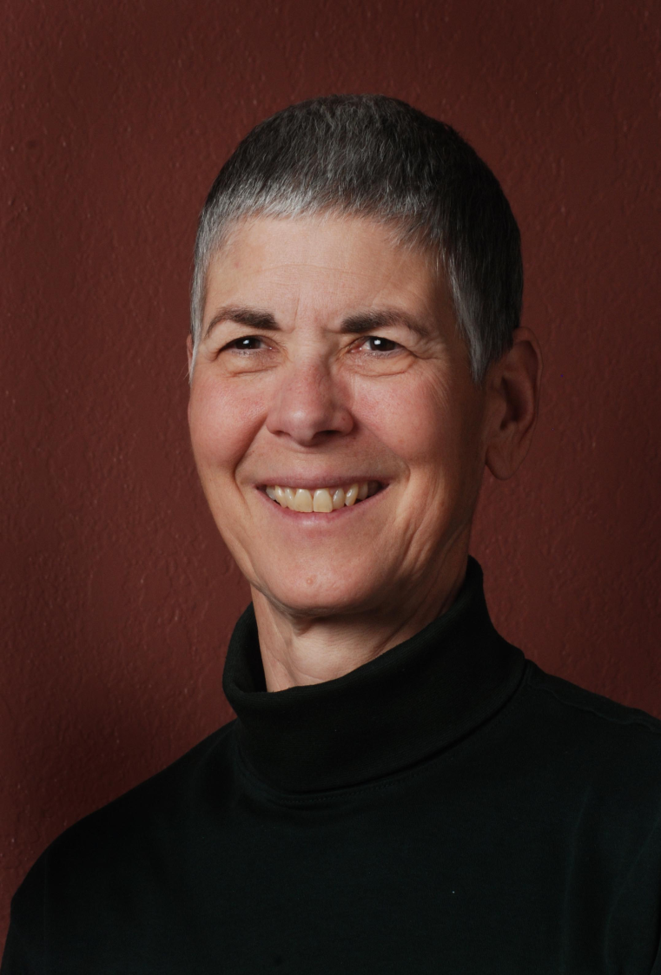
JENNY STONE
NATA Member Since 1975
WATC Member District 7
1995 - 2004

Slide 50
JENNY STONE
EDUCATION
BA Education, Gettysburg (PA) College
MS Education, University of Arizona
CERTIFICATIONS
Strength and Conditioning Coach (CSCS)
American Registry of Radiologic Technologists, Certified Limited Scope X-Ray Technologist
CURRENTLY
Assistant Athletic Trainer, U.S. Air Force Academy

Slide 51
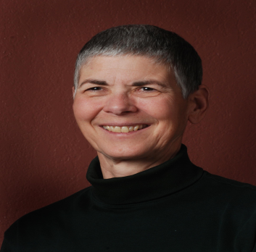
JENNY STONE
Rocky Mountain Athletic Trainers Hall of Fame
Colorado Athletic Trainers Hall of Fame
Head Athletic Trainer 1994 (Lillhammer) & 1992 (Albertville) Olympic Winter Games
Head Athletic Trainer 1988 (Seoul) Olympic Summer Games
Head Athletic Trainer 1987 (Indianapolis) & 1983 (Caracas) Pan American Games
Staff Athletic Trainer 1984 (Los Angeles) Olympic Summer Games

Slide 52
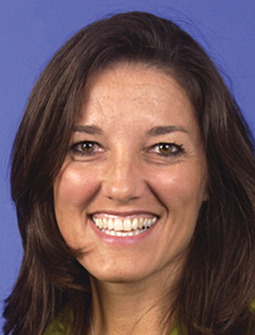
KATHLEEN STROIA
NATA Member Since 1981
WATC Member District 9
1995 - 1999

Slide 53
KATHLEEN STROIA
EDUCATION
BA Movement & Sports Sciences Specialization, Athletic Training Purdue University
BS Physical Therapy, The Chicago Medical School
MS Athletic Training, West Virginia University
CURRENTLY
Senior Vice President- Sport Sciences & Medicine and Transitions, Women’s Tennis Association

Slide 54
KATHLEEN STROIA
2015-16 Appointed USTA Sport Science Committee Chair
(2015-2016 term) – committee member 18 years
2012 Olympic Games, London, England, UK Primary Health Care
Provider (Physical Therapist/Certified Athletic Trainer)
2012 Recognized for 15 Years of Service, United States Tennis Association (USTA)
2011-Present - The Professional Association of Athlete Development Specialists (PAADS), Board of Directors Member and Chair
2007 Recipient of the International Tennis Hall of Fame, Tennis Educational Merit Award
2007 Recipient of the Most Distinguished Athletic Trainer Award, NATA
2006 Recognized for 25 Years of Membership Award, NATA

Slide 55
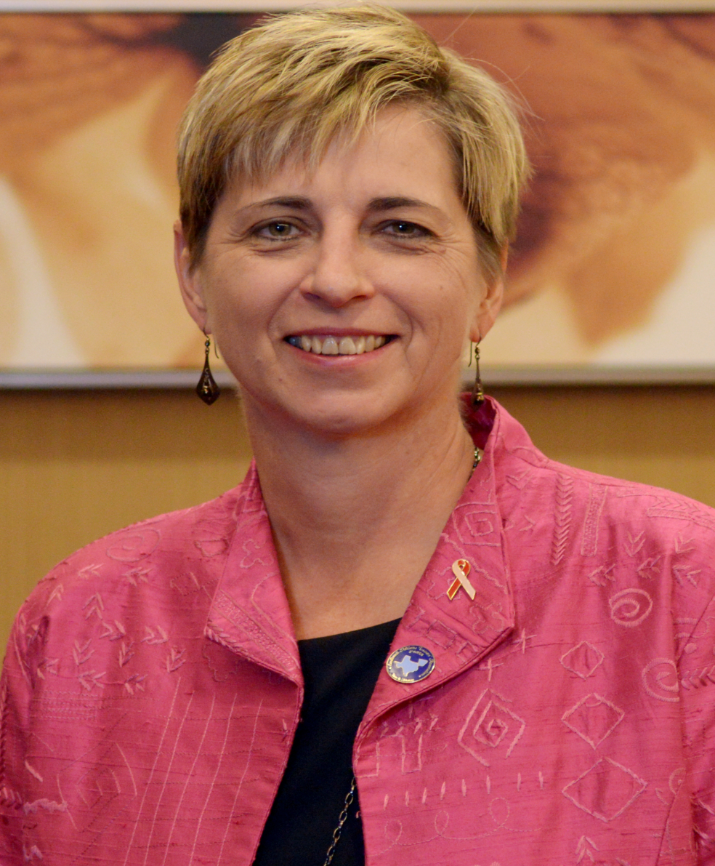
KATHY DIERINGER
NATA Member Since
1984
WATC Member District 6
1999 - 2003

Slide 56
KATHY DIERINGER
EDUCATION
BSEd University of Texas at Austin
MAEd Eastern Kentucky University
EdD University of North Texas
CURRENTLY
Owner/President 2003-present
D&D Sports Med Denton/Sanger/Aubrey

Slide 57
KATHY DIERINGER
2014 – Present, NATA Secretary/Treasurer
2012 – Present, District Director
2007 District VI Hall of Fame
2007 NATA MDAT 2006
2004-2005 District VI President
2002 NATA Service Award

Slide 58
KATHY TATE MEYER
NATA Member Since
1984
WATC Member
District 4
2001 - 2008

Slide 59
KATHY TATE MEYER
EDUCATION
BS in Physical Education. Teacher’s Certificate K-12, Southern Illinois University
MS in Physical Education with Specialization in Athletic Training, Illinois State University
CERTIFICATIONS
Massage Therapy Certification, Healthy Lifestyle School of Massage Therapy
Nationally Certified in Therapeutic Massage and Bodywork
Precision Neuromuscular Therapy Certification, NMT Midwest, Inc
CURRENTLY
Instructor for NMT Midwest, Inc. Sole Proprietor, Neuromuscular Therapy, Champaign, IL

Slide 60
KATHY TATE MEYER
2015 - NATA Athletic Training Service Award
2005-2007 - Vice Chair, Illinois Department of Professional Regulation Athletic Training Board
2000-2005 - Board Member, Illinois Department of Professional Regulation
2000 - Induction into the Illinois Athletic Trainers’ Hall of Fame
1994 - IATA recognition for Leadership as ATC for Prairie State Games
1990 - Certificate of Achievement from Governor of Illinois for Dedicated Service to Prairie State Games

Slide 61
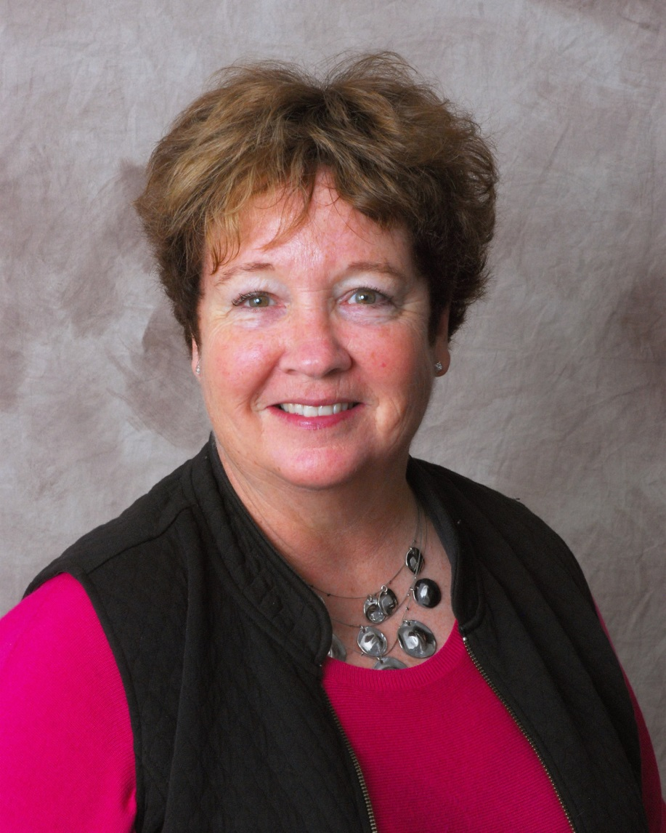
KATIE GROVE
NATA Member Since 1974
CHAIR, Women in Athletic Training Task Force 1995 – 1996
CHAIR~Women in Athletic Training Committee
1996 - 2000

Slide 62
KATIE GROVE
EDUCATION
BS in Physical Education specialization pre-Physical Therapy from University of Montana
MS in Physical Education specialization Athletic Training from Indiana State University
PhD in Human Performance with a specialization in Physical Medicine and Rehabilitation from University of Missouri
CURRENTLY
Director of Athletic Training Undergraduate Education at Indiana University - Bloomington

Slide 63
KATIE GROVE
2015 Inducted into the NATA Hall of Fame
2012 Indiana Athletic Trainers’ Association Diversity Award
2009 Women’s Athletic Award Presented by Office for Women’s Affairs Indiana University
2009 GLATA Golden Pinnacle Award
2006 President Great Lakes Athletic Trainers’ Association,
2005 GLATA Dedicated Service Award
2004 President-Elect, Education Chair Great Lakes Athletic Trainers’ Association
2003 Indiana Athletic Trainers’ Association Hall of Fame
2001 Indiana Athletic Trainers Association Athletic Trainer of the Year – College Division
2000 - 2002 President Indiana Athletic Trainers’ Association
1999 NATA Twenty-Five Year Award Recipient
1998 Indiana Athletic Trainers’ Association President’s Excellence Award
1998 NATA Most Distinguished Athletic Trainer Award
1995/96 - 2000 Formed the Women in Athletic Training Task Force/Committee

Slide 64
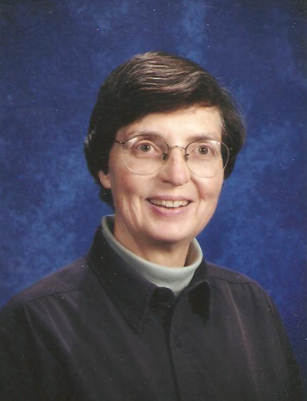
KAYE COSBY
NATA Member Since 1973
WATC Member District 6
1995 - 1998

Slide 65
KAYE COSBY
EDUCATION
BS from The University of Texas in Austin
MS from Indiana State University
CERTIFICATIONS
EMT
Wilderness First Aid Certification
CURRENTLY
Naturalist of a huge volunteer workforce dedicated to the Conservation, Preservation and
Restoration of our natural resources and promote Ecological Education of all
ages.

Slide 66
KAYE COSBY
2011 - Inducted into the
Inaugural Hall of Fame of the Alamo Area Athletic Trainers' Association
1998 – NATA Twenty-five
1989 – 2005 Lead Athletic Trainer for the Edgewood I.S.D. in San Antonio, Texas
1984 – First Head Women’s Athletic Trainer at Texas Tech University
1976 - 7th woman in the
State of Texas to receive Athletic Training Licensure

Slide 67
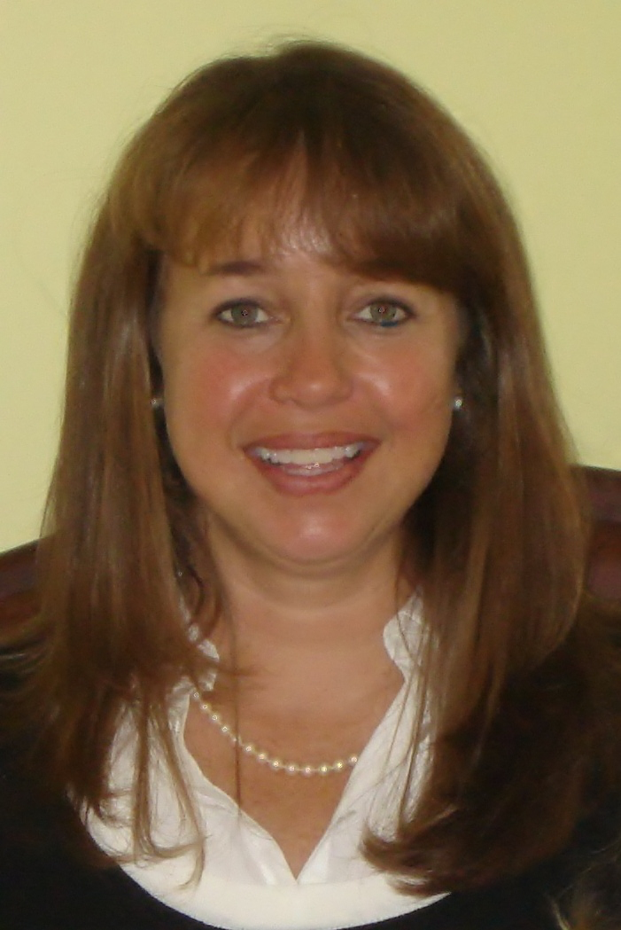
KELLI SABISTON
NATA Member Since
1985
WATC Member District 9
2003 - 2005

Slide 68
KELLI SABISTON
EDUCATION
BS Wake Forest University
MS University of North Carolina
CURRENTLY
Science Teacher /Athletic Trainer – Johnston County (NC) Schools

Slide 69
KELLI SABISTON
2012 NATA Most Distinguished Athletic Trainers’ Award
2005 NATA Service Award
2004-05 SEATA (D9) Vice President
1999 SEATA (D9) Secondary School Athletic Trainer of the Year Award
1996 Summer Olympic Games in Atlanta, GA
Georgia Athletic Trainers’ Assoc. President – 1997-2001
Dedicated Athletic Training Room, “Kelli Sabiston”

Slide 70
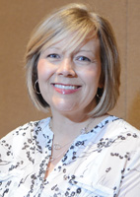
KEMBRA L. MATHIS
NATA Member Since
1996
WATC Member District 5
2004 - 2006

Slide 71
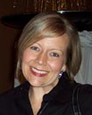
KEMBRA L. MATHIS
EDUCATION
BS Sports Medicine and Athletic Training, Missouri State University
MEd Guidance Counseling, Northeastern University, Tahlequah
CERTIFICATIONS
Teaching certificates for k-12 Spanish,
Health and PE, Guidance Counseling,
Medical Professions, and Sports Medicine
CURRENTLY
Sports Medicine Instructor, Bentonville High School

Slide 72
KEMBRA L. MATHIS
2015 President - Arkansas Athletic Trainers’ Assoc.
2014 NATA service award
2012 SWATA Secondary School Chair
2012 NATA Secondary School Rep.-D6
2010 Educator of the Year for ArkAHPERD
2009 AR Athletic Trainer of the Year
2009 Created a Sports Medicine Curriculum for the Career and Technical Education Dept in AR.
OK WATC rep 2003-2005
MAATA Life balancing rep briefly before moving to a new district-2005-2006
2008 AATA Secondary School Chair

Slide 73
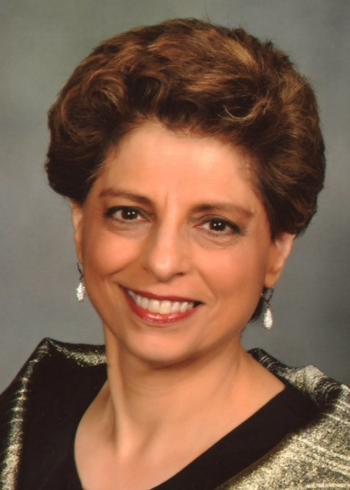
LAURIE SAMET
NATA Member Since
1978
WATC Member District 2
1997 - 2001

Slide 74
LAURIE SAMET
EDUCATION
AB English, Lafayette College
MS Physical Therapy, Duke University
DPT Regis University
SPECIALITIES
Sports Clinical Specialist (SCS) American Board of Physical Therapy Specialties since 1994
Orthopaedic Clinical Specialist (OCS) American Board of Physical Therapy Specialties since 1997
CURRENTLY
Laurie Samet Physical Therapy since 1995

Slide 75
LAURIE SAMET
Returning to my hometown in 1995 to
open my own physical therapy practice and maintaining my professional independence and autonomy since then, while being close to home and family.
Honored to be a part of:
Title IX, which, in the mid 1970s, gave me the opportunity to participate in interscholastic sports, which led to my interest in athletic training
Working with Pinky Newell at Purdue at the beginning of my career (1982 to 1984)

Slide 76
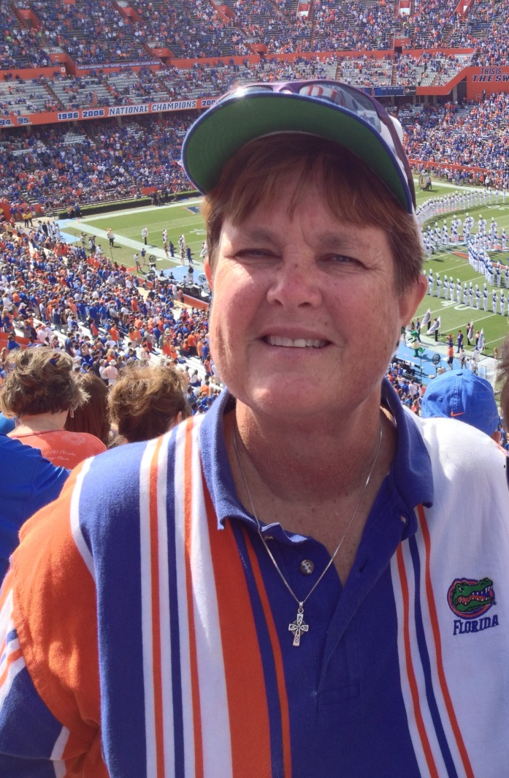
LISA (TINKER) MARSH
NATA Member Since
1976
WATC Member District 9
2000 - 2002

Slide 77
LISA (TINKER) MARSH
EDUCATION
BS University of Florida
MA University of Central Florida
EdD University of Central Florida
CERTIFICATIONS
NBPTS, NATA, EMT, CPR, HtC
CURRENTLY
Dr. Phillips HS Teacher, Wellness & HIV/AIDS rep, McKinney-Vento (homeless) liaison

Slide 78
LISA (TINKER) MARSH
ATAF- HS Athletic Trainer of the Year
Hall of Honors- CAPS/SGMA National Faculty
Teacher of the Year, DPHS
EdD dissertation on Job Satisfaction of
ATCs in Ed. settings in Southeast US
Medical Academy Director at DP for
over a decade

Slide 79
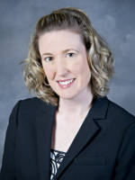
MARY MCLENDON
NATA Member Since
1993
WATC Member District 9
2005 - 2008

Slide 80
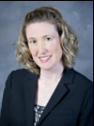
MARY MCLENDON
EDUCATION
BS University of Colorado
MS University of Florida
CURRENTLY
Director of Sports Medicine/ Head Athletic Trainer at Mississippi State University

Slide 81
MARY MCLENDON
Moderator for NATA Life Balance Think Tank
StarTRACK Leadership Scholar

Slide 82
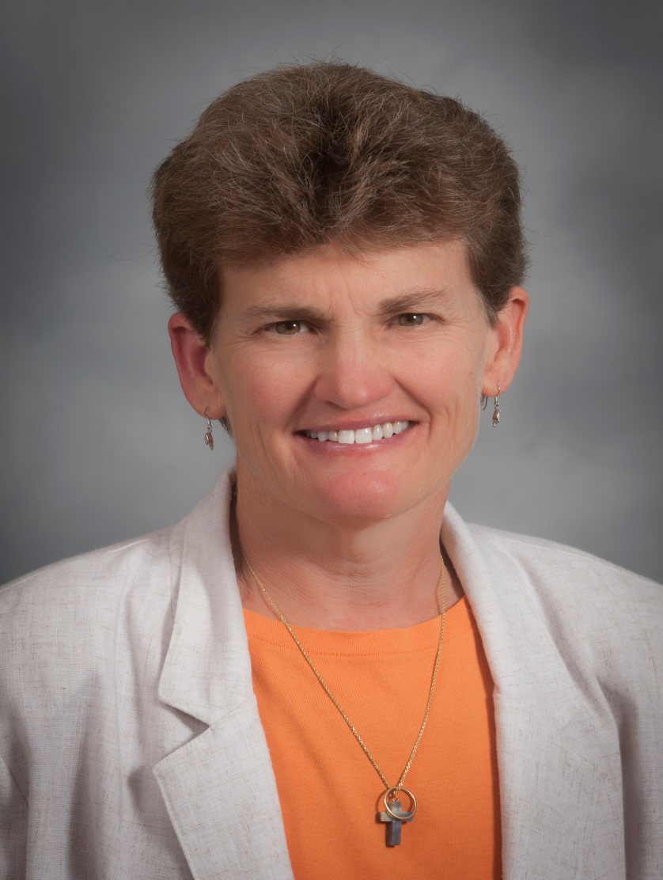
PATRICIA ARONSON
Joined NATA
1981
WATC Member District 3
1996 - 2005

Slide 83
PATRICIA ARONSON
EDUCATION
BS Physical Education with a specialization in Athletic Training in a NATA approved program Canisius College
MEd Education with a specialization in Athletic Training/Sports Medicine in a NATA accredited graduate program University of Virginia
PhD University of Virginia
CURRENTLY
AT Faculty, Lynchburg College

Slide 84
PATRICIA ARONSON
NATA Board of Directors
- MAATA/D3 first female District Director
- MAATA/D3 first female District Secretary
NATA MDAT Award
NATA Service Award
VATA Hall of Fame– first female
NATA WATC Member
VATA President – 1st female

Slide 85
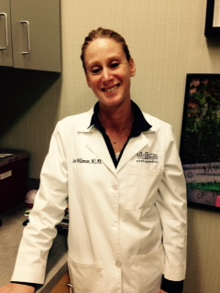
SARA WILLIAMSON
NATA Member Since
1990
WATC Member District 8
2002 - 2008

Slide 86
SARA WILLIAMSON
EDUCATION
BS East Stroudsburg University
MS James Madison Univ.
CURRENTLY
Medical Assistant Valletta orthopedics

Slide 87
SARA WILLIAMSON
FWATA Treasurer 2008-2009
CATA Secretary 2007-2008
CATA Region 6 Director 2004-2007

Slide 88
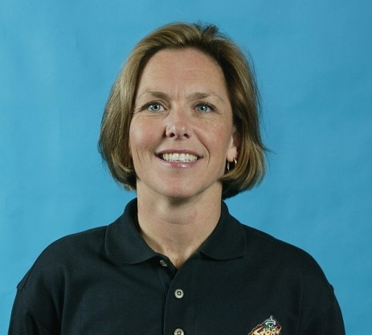
SHERI HEDLUND
WATC Member District 10
2003 - 2006

Slide 89
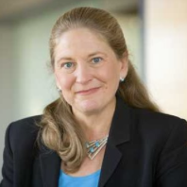
SUSAN PRESSLY LEPHART
WATC Member District 2
1995 - 1997

Slide 90
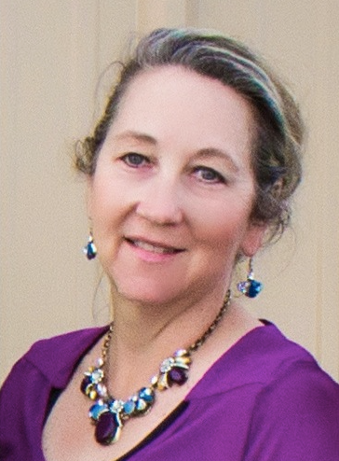
SYDNEY G. RINGER
NATA Member Since
1986
WATC Member District 5
2001 - 2003

Slide 91
SYDNEY G. RINGER
EDUCATION
BS Physical Education/Health, Oklahoma State University
MS Athletic Administration, The University of Tulsa
CURRENTLY
Head Athletic Trainer – Oklahoma Christian University

Slide 92
SYDNEY G. RINGER
Board of Directors’ District 5 Mid America Athletic Trainers’ Assoc.
Secretary/ Treasurer – Oklahoma Athletic Trainers’ Association Executive Committee

Slide 93
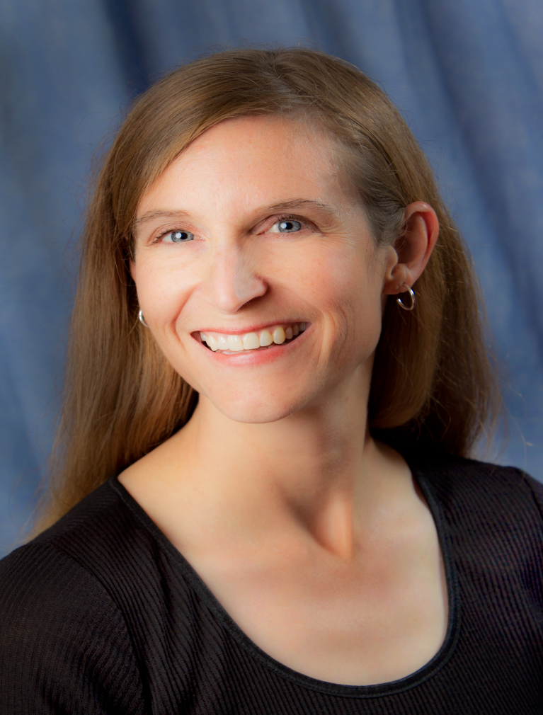
TAMARA VALOVICH-MCLEOD
NATA Member Since 1994
WATC Member District 7
2004 - 2008

Slide 94
TAMARA MCLEOD
EDUCATION
BS Sports Medicine, Mercyhurst College
MS Kinesiology, University of Colorado
PhD Sports Medicine, University of Virginia
CURRENTLY
Professor and Program Director, Athletic Training Programs, A.T. Still University

Slide 95
TAMARA MCLEOD
Fellow ~ NATA
Trustee, United States Brain
Injury Alliance
Section Editor, Journal of Athletic Training
NATA Foundation, District 7 Director
Arizona Interscholastic Association Sports Medicine Advisory Committee

