Slide 1
NATAPAC Overview
Review of association PACs and NATAPAC financials
March 30, 2026

Slide 2
2023-2024 Association PACs by the numbers
722
317
1,039
+
=
trade PACs
membership PACs
association PACs
Total receipts
Total disbursements
$170M
$176M
$171M
$177M
TOTAL
TOTAL
$346M
$348M
■ Trade
■ Membership
■ Trade
■ Membership

Slide 3
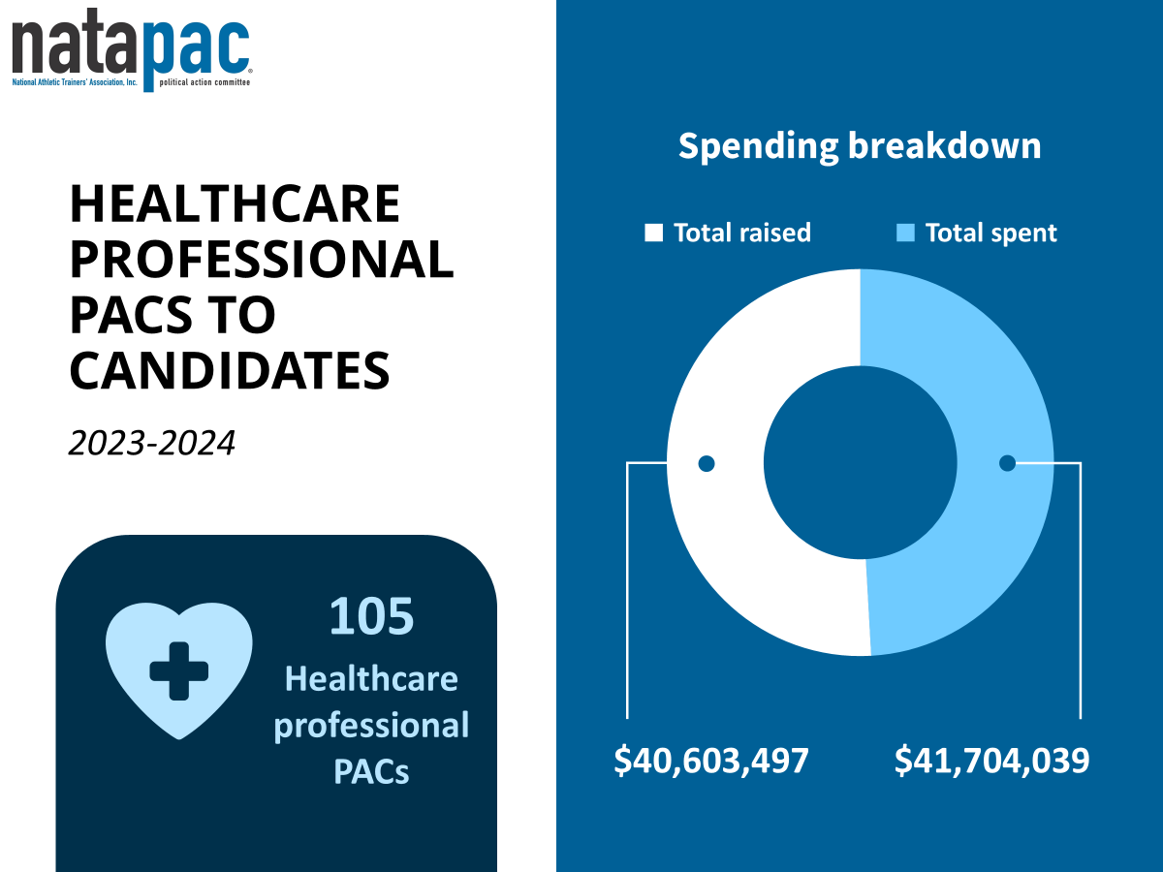
Healthcare professional PACs to candidates
Spending breakdown
■ Total raised
■ Total spent
2023-2024
$40.6M
$41.7M
TOTAL
$80.42M
722
Healthcare professional PACs
$40,603,497
$41,704,039

Slide 4

Peer comparison; 2023-2024 cycle
■ Total Receipts ■ Total Disbursements ■ Cash on Hand

Slide 5

Disbursements
2023-2024 CYCLE
Senate candidates
House candidates
$70,000 disbursed by NATAPAC to support NATA Advocacy efforts
100% win rate!
■ Democrats
■ Republicans
2025-2026 CYCLE
$24,500 disbursed to date
Another $50,000 approved by the NATAPAC contributions subcommittee for disbursement

Slide 6
Fundraising
Overall, the average percent of members who invest in the PAC annually fluctuates right around 2.75%.
Biggest sources of fundraising
Top causes of contributor and amount raised fluctuations
Recurring monthly contributions
1
Members retiring
Chuck Kimmel Memorial NATAPAC luncheon (get your 2026 tickets!)
2
Changes in membership numbers
Dues Renewal
3
Leadership turnover
NATAPAC Sweepstakes
4

Slide 7
2025
2024
2023
901
NATA Members invested in NATAPAC
841
NATA Members invested in NATAPAC
920
NATA Members invested in NATAPAC
$68,035.22
Total raised
$62,651.80
Total raised
$64,838.43
Total raised
$75.51
Average contribution
$74.49
Average contribution
$70.47
Average contribution
Top contributing districts:
Top contributing districts:
Top contributing districts:
District 9
District 5
District 6
District 9
District 5
District 6
District 9
District 5
District 6
22
Olympian Level contributors ($500+ annually)
15
Olympian Level contributors ($500+ annually)
17
Olympian Level contributors ($500+ annually)

