Slide 1
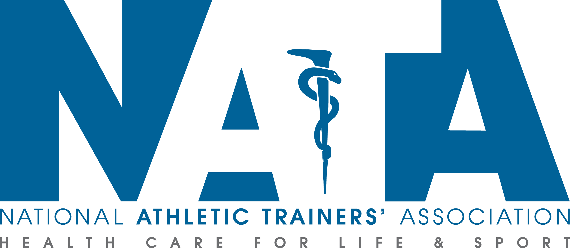
Sudden Cardiac Arrest in
Intercollegiate Athletics

Slide 2
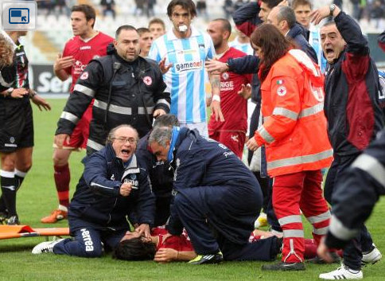
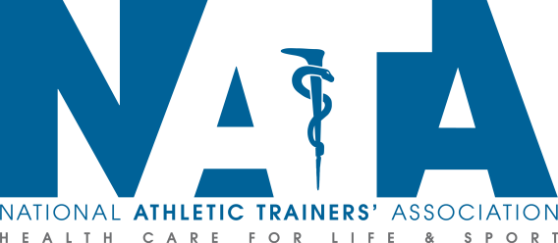
Sudden Cardiac Arrest in Intercollegiate Athletics
Are you prepared ?

Slide 3
Sudden Cardiac Arrest (SCA) in Collegiate Student Athletes
Sudden fatality from a heart condition remains the leading medical cause of death in college athletes
Prevention starts with the Pre Participation Physical
Emergency Action Plan for Cardiac Arrest must be established, communicated, and rehearsed

Slide 4
Pre-Participation Evaluation of Student Athlete
Cardiac specific portion of PPE consists of the following:
  Comprehensive personal and family history
  Physical Examination
    American Heart Association 14 point evaluation or
    Pre-Participation Physical Evaluation Monograph, 4th Edition
If ECG is included with the above, best practices include:
  Pre ECG screening planning is performed with a multidisciplinary team
  The student-athlete is provided an in-depth explanation for the rationale of the ECG screening and the possible risk vs benefit of adding ECG Screening
  Modern athlete-specific ECG interpretation standards are used
  Skilled cardiology oversite is available
Notes:
“

Slide 5
Common Causes of SCA
  Arrythmias
  Hypertrophic Cardiomyopathy
  Inherited Cardiac Conditions
  Commotio cordis
  Myocarditis
Notes:
“

Slide 6
Preparation and Planning
  Preparation is the key to survival once sudden cardiac arrest has occurred
    Emergency Action Plan that encompasses Sudden Cardiac Arrest
    Protocols must be location and situation specific
    All staff, including coaches, must be aware of protocols
    EAP must be widely distributed and rehearsed regularly

Slide 7
Taking Action:
Recognizing Signs and Symptoms
  Collapsed and unresponsive
    SCA should be suspected in any non-traumatic collapse
  Gasping, agonal breathing
  Seizure like activity, involuntary arm and leg movements
    Seizure=SCA until proven otherwise
  A blow to the chest: Direct impact to the chest can cause cardiac arrest

Slide 8
Taking Action:
Activate EMS and Begin CPR
  Activate EAP and contact EMS immediately
  Locate and acquire AED, begin CPR according to training
  Those not performing CPR or preparing AED should clear path for ambulance
  Continue CPR until EMS arrives or patient shows signs of life

Slide 9
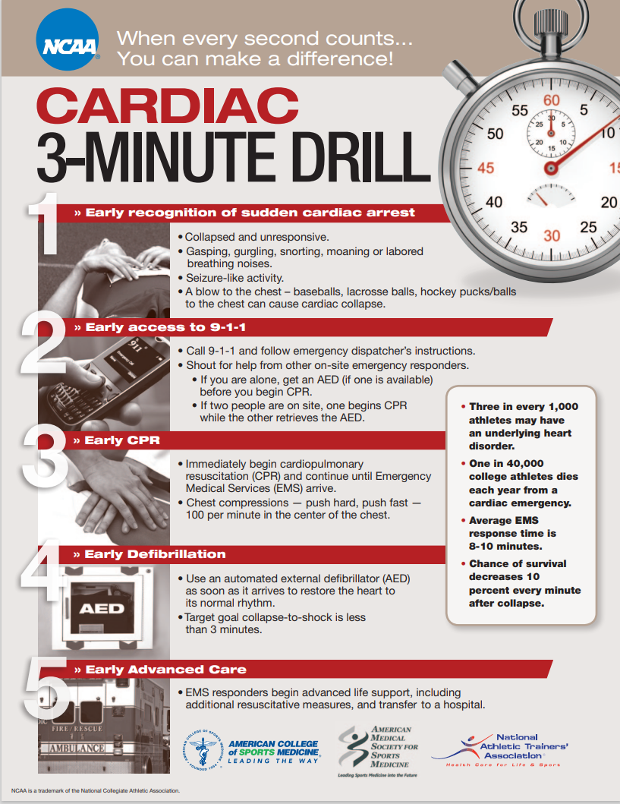

Slide 10
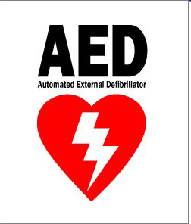
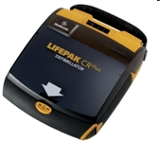
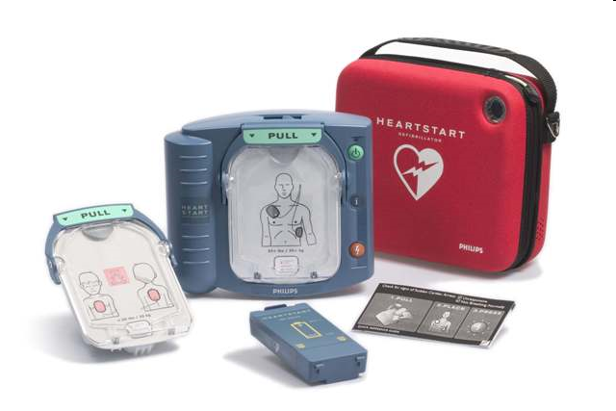

Availability of AEDs
The single greatest factor affecting survival is the time from cardiac arrest to defibrillation (shock)
AEDs improve survival through early defibrillation
Survival rate decreases by 10 % for ever minute an AED is not being used

Slide 11
References
Hainline B, Drezner J, Baggish A, et al. Interassociation Consensus Statement on Cardiovascular Care of College Student-Athletes. J Am Coll Cardiol. 2016 Jun, 67 (25) 2981–2995. https://doi.org/10.1016/j.jacc.2016.03.527
2014-15 NCAA Sport Medicine Handbook
K. Harmon, I. Asif, D. Klossner and J. Drezner “Incidence of Sudden Cardiac Death in National Collegiate Athletic Association Athletes”. Circulation. 2011;123:1594-1600; originally published online April 4, 2011
National Athletic Trainers' Association Position Statement: Preventing Sudden Death in Sports. JAT. 2012 Jan-Feb 47(1) 96-118
NCAA Cardiac 3 Minute Drill Handout. (https://ncaaorg.s3.amazonaws.com/ssi/cardiac/SSI_Cardiac3minDrill.pdf)
Sudden Cardiac Death in Athletes - Cardiovascular Disorders - Merck Manuals Professional Edition

