Slide 1

Heat Illness in Intercollegiate Athletics

Slide 2

Exertional Heat Illness Prevention
Identification of those athletes more predisposed or have previous history (Insert list of particular student-athletes here as needed)
Special considerations and modifications are needed for those wearing protective equipment during periods of high heat stress
Acclimatize athletes over a period of 7-14 days when possible
Educate athletes on prevention, recognition, treatment, risks, and how to pre-hydrate and rehydrate properly
Encourage proper sleeping, nutrition, dress and rest breaks to athletes
Weigh athletes to determine pre and post exercise weight to ensure proper rehydration
Check conditions and develop guidelines and modifications for exercise based on the wet bulb globe temperature (insert specific institutional guidelines here as needed)

Slide 3
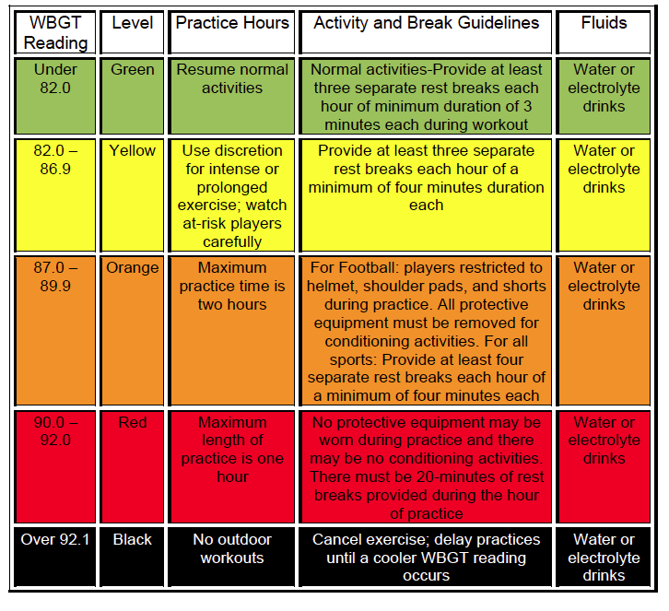

Slide 4
Heat Cramps
Heat (muscle) cramps tend to occur later in activity with muscle fatigue
Dehydration, diet, and large losses of sodium and other electrolytes increase the risk of muscle cramps
Recognition: Intense pain in muscles and persistent muscle contractions after prolonged exercise, most often with exercise in heat
Treatment: Regain normal hydration status and replace sodium losses via an electrolyte drink or other sodium source
  Salty sweaters may need additional sodium earlier in activity
  Light stretching, relaxation of involved muscles
Return to play Considerations: Student-athletes should be assessed to determine if they can return to participation
  Diet, rehydration practices, electrolyte consumption, fitness status and level of acclimatization and use of dietary supplements should be assessed and possibly modified

Slide 5
Heat Exhaustion
Heat exhaustion is a moderate heat illness that occurs when the student-athlete continues physical activity after they start suffering from the ill effects of heat, like dehydration
Recognition: Physical fatigue, dehydration and or electrolyte depletion, coordination loss, fainting, dizziness, profuse sweating, pale skin, headache, nausea, vomiting, diarrhea, stomach/intestinal cramps, rapid recovery with treatment
Treatment: Remove student-athlete from play to a shaded or air conditioned area, remove excess clothing and equipment
  Cool student-athlete with legs propped above heart level
  If not nauseated, or vomiting rehydrate with chilled water or sports drink
  If student-athlete cannot take fluids orally intravenous fluids are indicated
  Transport to an emergency facility if rapid improvement is not noted with prescribed treatment.
Return to play Considerations: Student-athlete should be symptom free and fully hydrated
  Clearance from a physician or at least consultation with a physician is recommended
  Underlying conditions or illness needs to be ruled out
  Intense practice in heat should be avoided for at least one day
  If lack of acclimatization or inadequate fitness level was the cause of illness, correct this before the student-athlete returns to full-intensity training in heat

Slide 6
Exertional Heat Stroke
Heat Stroke is a severe heat illness that occurs when a student-athlete’s body created more heat than it can release, due to the strain of exercising in the heat
This results in a rapid increase in core body temperature, which can lead to permanent disability or even death if left untreated
Recognition: Increase in core body temperature, usually above 104°F
  Central nervous system dysfunction(CNS) (altered consciousness, seizures, confusion, emotional instability irrational behavior or decreased mental acuity
  Other indicators include: nausea, vomiting, diarrhea, headache, dizziness, weakness, hot and wet or dry skin, increased heart rate, decreased blood pressure or fast breathing, dehydration, and combativeness
Treatment: AGGRESSIVE AND IMMEDIATE whole body cooling
  Cold water immersion (35°- 38° F) within minutes is the best treatment until core temperature reaches 101° - 102°F
  Contact emergency medical services for transport
  Monitor airway, breathing, circulation, core temperature, and CNS
  If immersion is not possible use alternate methods such as spraying the body with cold water, fans, ice bags or cold towels (replaced frequently), and transport immediately to a medical facility. COOL THEN TRANSPORT!

Slide 7
Exertional Heat Stroke
Return to play Considerations: Physician clearance is necessary before return to physical activity
  The severity of the incident should designate the length of recovery time
  The student-athlete should avoid exercise for the minimum of one week after release from medical care
  Underlying conditions or illness needs to be ruled out
  A gradual return to physical activity should begin under the supervision of an certified athletic trainer or other qualified medical professional

Slide 8
Tips for Coaches and Student-Athletes
Coaches and Administrators
  Be aware of temperature and humidity levels
    Change practice length, intensity and equipment use as the levels rise
  Remind student-athletes to drink regularly
    Schedule frequent fluid breaks and increase the frequency as heat and humidity levels rise
  Know the signs and symptoms of heat illness and get student-athletes checked out by medical staff
  Have an emergency action plan for obtaining medical services and know the plan and how to carry it out
Student Athletes
  Hydrate properly before, during and after exercise
  Know that nutritional supplements especially those with caffeine can have a negative impact on hydration and or increase metabolism and heat production
  Know that certain medications can have similar effects as supplements, e.g. antihistamines, decongestants, certain asthma medication, Ritalin, diuretics and alcohol
  Know the signs and symptoms of heat illness and report them

Slide 9
Heat Acclimatization Recommendations
NCAA Football: Allow a 14 day heat acclimatization period prior to full-scale athletic participation
Day 1-5: only 1 practice/day
If interrupted by weather or heat, practice begin once safe but total time does not exceed 3 hours
1 hr. walk-through permitted, but need at least 3 hr. recovery between practice and walk-through
Day 1, 2: Only helmet worn. Day 3-5: Only helmet and shoulder pads
Day 6-14: All protective equipment and full contact can begin
Two-a-day practices now discontinued at NCAA level
  A second session may include walkthroughs or meetings but no helmets, pads or conditioning
All sessions must be separated by a 3 hr. recovery time
  Time spent receiving medical treatment and eating meals may be included as part of the recovery time
Multiple practice sessions should not exceed 3 hours, and athletes should not participate in more than 5 total hours in one day
  Warm-up, stretching, cool down, walk-through, conditioning, weight lifting are included

Slide 10
References
National Athletic Trainers’ Association Position Statement: Exertional Heat Illnesses (2015)
https://www.nata.org/practice-patient-care/health-issues/heat-illness
National Athletic Trainers’ Association consensus statement (2003)
https://www.nata.org/sites/default/files/inter-association-task-force-exertional-heat-illness.pdf
National Weather Service
http://www.nws.noaa.gov/os/heat/index.shtml#heatindex
Korey Stringer Institute. http://ksi.uconn.edu/prevention/heat-acclimatization/
CDC https://www.cdc.gov/nceh/hsb/extreme/Heat_Illness/index.html

