Slide 1

Diversity, Equity, Inclusion and Accessibility in Sports

Slide 2

Equality vs Equity
Equality – Providing consistent and equal care throughout
Equity - Providing care that does not vary in quality because of personal characteristics such as gender, ethnicity, geographic location, and socioeconomic status.

Slide 3
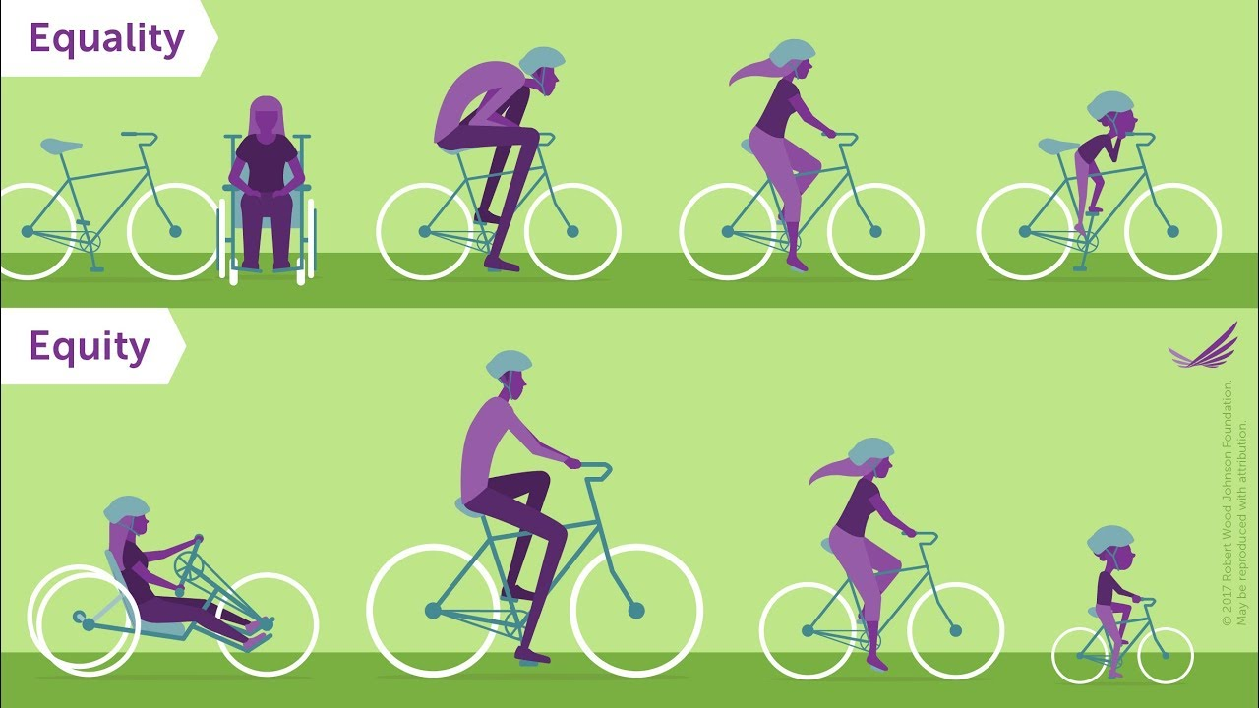
How do these differ?
Equality – providing the entire time with the same pair of shoes
Equity – providing everyone with a pair of shoes that fit
Equity takes into account history and biological factors to create a level playing field and equal opportunity for all

Slide 4
How to start
  Identifying individual needs of your student-athletes is the first step in equitable care
  Ask the student-athlete size preference, equipment modifications, or other necessary items they may need in order to be successful
  Reflection on past and current treatment of athletes is critical for enhanced future performance
  Identify any unconscious bias you may have towards preferential treatment of one race, ethnicity, or gender
  Make efforts to diversify your coaches, support staff, and athletes to create an environment of inclusion

Slide 5
How to help
Arm yourself with knowledge about historical limiting factors
  Much of the battle fought today is due to discrimination and inequality at the beginning of civilization
Make a conscious effort for diversity in your staff and recruitment
Perform a needs assessment for all athletes on a yearly basis, noting trends and consistent reports among similar groups
Never assume someone’s preferences based on identity, race, gender, or socioeconomic status

Slide 6
Myths
Disabled athletes are not as talented as nondisabled persons
  Given the proper adjustments, disabled athletes can compete alongside any other persons
You should avoid talking about someone’s disability or ethnicity in order to treat everyone as equals
  Ignoring someone’s history means ignoring a vital portion of who they are
  Have open and honest conversations with your athletes about what their disability is and how you can best help them compete, as well as acknowledging someone’s ethnic backgrounds and helping them celebrate their heritage and culture

Slide 7
DEI Hiring Practices
Things to keep at the forefront
  Cognitive Diversity
    Be aware of habits of hiring people who think like you
  Be purposeful in your search
  Inclusion
    Make sure sound DEI practices are in your included in your processes

Slide 8
Resources available
[Insert your Athletic Department info]
Athletic department mental health services
Campus counseling center
988 – Suicide and Crisis Lifeline (call and text)
The Ross Initiative in Sports for Equality (RISE)
NCAA Office of Inclusion
NCAA Champions of Respect-Inclusion of LGBTQ Student-Athletes and Staff in NCAA Programs
Racial Equality Tools Glossary - https://www.racialequitytools.org/glossary#diversity
Anti-Racist Resources, Sports Edition - https://docs.google.com/document/u/1/d/1pJsFEMh8qdT8an_yHsQ4gptX1Beb1G2BSemjkaupZOw/mobilebasic?fbclid=IwAR01PnKQ3Q6rJJ7V6KyZSm8EwsTCFcVThWFzn7u2GFZ7kKfs21AWYGtbNHg
Jen Fry Talks - https://jenfrytalks.com/resources/

Slide 9
References
Ross Initiative in Sports for Equality
Robert Wood Johnson Foundation
Team USA Diversity, Equity, and Inclusion

