Slide 1
Player Safety in College Football: Responsibility, Authority, Accountability
Charlie Thompson, MS, ATC
Head Athletic Trainer
Princeton University
Notes:
On behalf of the National Athletic Trainers Association, I’d like to thank Coach Teaff and the leadership of the American Football Coaches Association, for including athletic trainers in your program. The NATA and athletic trainers across the country are committed to making football a safer sport, fully realizing that it is perhaps the most physical of all of the sports we work with.

Slide 2
Two Major Priorities
Preventing sudden death in strength and conditioning activities
Reducing the number of helmet contacts in order to reduce the number of concussions and risk of debilitating cervical spine injuries
Notes:
The NATA has two areas of concern that we’d like to work with the AFCA on. The first is preventing sudden death during strength and conditioning activities. These are preventable deaths, and represent unacceptable collateral damage. The impact of these tragedies is immeasurable. This issue can’t be ignored nor it’s ramifications downplayed. The second is the issue of concussions. Since 1977, it has been illegal to use the crown of the helmet to, “ram, butt, or spear”, as the original wording was written.
The opportunity to be on any of the various sports highlight shows, to be lionized by the game announcers, and to be known as guy who “blows up’ the other guy, is very alluring to young athletes. We all have to walk that fine line with them, encouraging them to be physical while at the same time, utilizing the techniques that they are taught.

Slide 3
Important Documents
Consensus Statement- Intra Association Task Force on Preventing Sudden Death in Strength and Conditioning Activities
USOC, NCAA, NATA, NSCA, CSCCa, AMSSM, ACSM, CDC, AOSSM, NASM
NATA Official Statement – Calling Crown of the Helmet Violations
Supported by A MSSM, American College of Emergency Physicians, PFATS, NAN, ACSM, AOASM
Notes:
I’d like to call your attention to two documents that have been developed in the last year. The first is a consensus statement on the Sudden Death issue. This document was the combined work of many concerned groups, including the NATA, NCAA, NSCA, CSCCa, ACSM, and several others.
The second document was developed by the NATA and is supported by several other concerned groups. It addresses the issue of calling penalties for crown of the helmet hits.

Slide 4
Preventing Conditioning Deaths
Since 2000, there have been 21 deaths related to conditioning activities
75% were Division 1 players
11/ 21 deaths occurred on Day 1 or Day 2 of conditioning
Fortunately and coincidentally, there have not been any deaths related to actually playing FB
Referred to in the media as “the Funeral Season” and ‘the Killing Season”
Notes:
Since the year 2000, there have been 21 deaths in college football related to conditioning activities. 75% of these deaths occurred at the Division 1 level. 11 out of 21 occurred on Day 1 or Day 2 of conditioning, calling into question the overall planning and possibly the purpose of these sessions.
These deaths have not been ignored in the media. There have been articles in the media referring to the off-season as “Funeral Season” and “The Killing Season”.
Fortunately, there have not been any deaths related to actually playing football, again, calling into question how we are running our conditioning programs. It has also been three years since the last death.

Slide 5
Preventing Conditioning Deaths
Progressive acclimitization
Gradual increase in new conditioning activities
Eliminate exercise as a form of punishment
Ensure proper education, experince, and credentialing of the S & C staff
Appropriate medical coverage
Familiarization of Emergency Action Plans (EAP)
Awareness of individual medical conditions
Notes:
The recommendations in the consensus statement are as follows:
Allow for progressive acclimatization to the activity and the environment, if indicated.
Utilize a gradual increase in the intensity of new activities, allowing for the necessary physiologic changes to occur.
Eliminate exercise as a form of punishment. Find more efficient, safer methods.
Ensure the proper education, experience, and credentialing of S & c staff.
Ensure that there is proper medical coverage and communication. Work within the staffing constraints of your institution.
Be familiar with and follow the institution’s Emergency Action Protocols, especiall if you do not have on- site medical care.
Make sure all personnel involved are aware of individual medical conditions that may be exacerbated by certain types of physical activity.

Slide 6
Preventing Concussions
Issue has taken on a life of it’s own
Concern at all levels of Football
The same can be said of any sport that involves contact
More of an issue with Football because of the popularity and the media attention the sport receives
The popular culprits are “launching” and “targeting” by tacklers, along with hits on the “defenseless player”, with little to no attention to the ball carrier that purposely lowers his head just before contact
Notes:
The issue of concussions has taken on a life of its own. The number of new experts in this area is staggering. This is a phenomenon that we have to get a handle on.
The popular culprits are “launching” and “targeting” by tacklers, along with hits on the “defenseless player”, with little to no attention to the ball carrier that purposely lowers his head just before contact
There are concerns at every level of football, and in other sports as well.
The difference is the popularity of football and the media attention that the sport receives.
The enforcement of the rule(s) have been uneven and infrequent.
The helmet is designed to prevent blunt trauma and will not stop concussions.
We need to educate all of our players- blockers, tacklers, and ball carriers.

Slide 7
Preventing Concussions
Enforcement of the existing rules is uneven and infrequent
Helmet is designed to prevent blunt force trauma- they will NOT prevent concussions
Need to educate tacklers, blockers, and runners
Notes:
The rule is very clear. It was modified in 2005 when a large group, including coaches, officials, athletic trainers, doctors, and others, met at this meeting to address the concerns and make the rule as clear as possible. The word “intent” was removed in order to help the officials make the calls.

Slide 8
Helmet Contact Issues
Rule 9-1-3a
"No player shall initiate contact and target an opponent with the crown (top) of his helmet. When in question, it is a foul"
Rule 9-1-3b
No player shall initiate contact and target a defenseless opponent above the shoulders. When in question, it is a foul"
Under "Points of Emphasis" the following language addresses our topic:
"Intentional helmet-to-helmet contact is never legal, nor is any blow directed toward an opponent's head. Flagrant offenders shall be disqualified"
Notes:
The responsibility and the authority for these two issues are shared by coaches, the medical staff, game officials, and anyone else with a vested interest in the sport of football.

Slide 9
Responsibility and Authority
Shared by
Coaches
Medical Staff
Officials
Anyone else with a vested interest in the sport of Football
Notes:
As coaches, you have the responsibility to provide for a safe environment on and off the field and to promote safety as a priority in all aspects of your program. We encourage you to continue to teach proper tackling and running technique for all players. We encourage you to continue to support the notion of reporting concussions and for players to look out for their teammates.
We also hope that, as coaches, you will help to educate the members of the media as to what constitutes the kind of physical play you expect from your players. They can be as big of a help as anyone in this regard.

Slide 10
Responsibility
Coaches-
Provide for a safe environment
Emphasize proper tackling/ running technique for ALL players
Support the notion of reporting concussions
Encourage the players to look out for teammates
Promote safety as a priority in all aspects of the program- conditioning
Find alternate method(s) of punishment
Notes:
It is the responsibility of the medical staff to educate the staff and players regarding concussions and other medical conditions, such as Sickle Cell Trait, asthma, and cardiac conditions that are potentially harmful. We also need to make sure that all staff members are aware of which athletes have a potentially dangerous medical condition that is exacerbated with some forms of exercise.
And we need to provide proper medical care regardless of how it is perceived by others, making the health and safety of the athletes our primary concern.

Slide 11
Responsibility
Athletic Trainers/ Medical Staff
Promote a safe environment
Educate staff and players regarding concussions
Adhere to recommended guidelines (Zurich) in regards to evaluation and RTP decisions
Provide all staff with pertinent, individual medical information
Educate staff regarding potential medical issues (SCT, asthma, etc.) for individual athletes
Provide medical care as necessary
Notes:
The game officials are responsible for enforcing the rules that are currently in the book. They should apply all the rules to all of the players on both sides of the ball. And they should understand the ramifications of using the crown of the helmet, especially as it relates to potentially devastating cervical spine injuries.

Slide 12
Responsibility
Officials
Enforce rules that are currently in the books
Don’t try to interpret intent if it is not a part of the rule
Apply rules to ALL players on both sides of the ball
Understand the ramifications of using the crown of the helmet
CERVICAL SPINE INJURIES
Notes:
In regard to authority, as coaches, you have the highest level of authority and can insist that the officials enforce the rules as written, remove players who are potential hazards to themselves and others, insist that all activities have a specific football purpose, and support the regulation of activities of at- risk athletes.

Slide 13
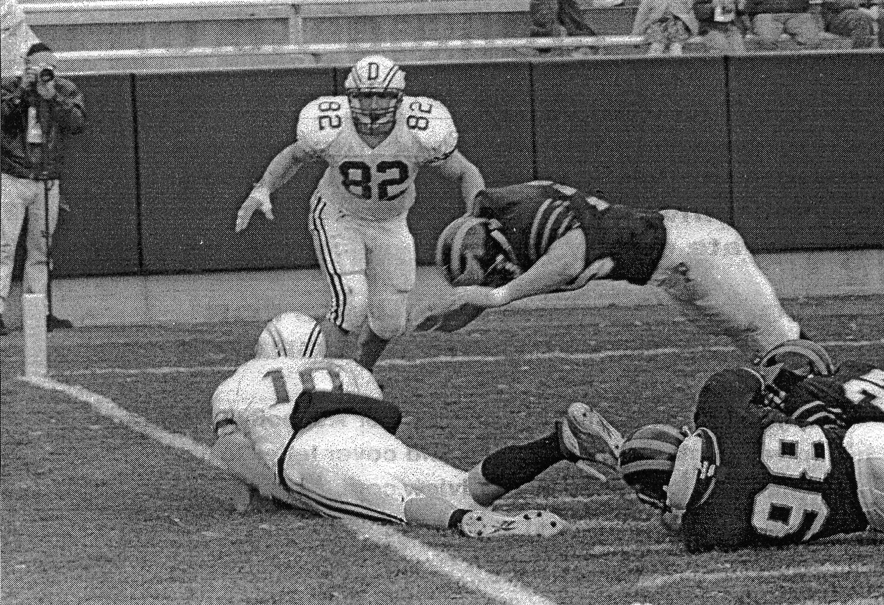
Authority
Coaches
Insist on officials enforcing the rules as written
Remove players that are potential hazards to themselves and others
Insist that all activities have a FB purpose and are safe for the average athlete
Regulate activities of at- risk athletes
Notes:
The medical staff must have the authority to remove athletes from activity as warranted, address environmental conditions, and indicate where activity modifications are a medical necessity. I believe this is the only area of authority the NCAA grants to someone other than the President of a university.

Slide 14
Authority
Medical staff
Remove athletes from activity as warranted
Address environmental concerns as necessary
Inform all staff of individual medical issues and modifications in activity, if necessary

Slide 15
Authority
Officials
Regulate the activity on the field
Notes:
The game officials have the authority to regulate the activity on the field. Plain and simple. We need the officials to understand the impact they can play in this area.

Slide 16
Responsibility
Coaches
Notes:
I have two significant fears. First, non- football people will feel compelled to get involved and take action that will seriously alter the sport we all love.
Second, people will continue to enjoy watching and attending football games, but will not allow their sons to play the game.

Slide 17
Accountability
We are all accountable
We can’t let it get to the point where non- FB people feel a need to step in
Teddy Roosevelt 1905!
In the end, the game itself is accountable
Notes:
Who’s accountable? We all are, individually, as a part of a football program, and as a part of the football community.
In the end, the game of football is accountable.

Slide 18
My Biggest Fears
Non- FB people will feel a need to step in and take action
People will always enjoy watching football, but will they allow their sons to play?
Notes:
I have two significant fears. First, non- football people will feel compelled to get involved and take action that will seriously alter the sport we all love.
Second, people will continue to enjoy watching and attending football games, but will not allow their sons to play the game.

Slide 19
Thank You!
Notes:
On behalf of the NATA, I’d like to once again thank you for this opportunity.

