Slide 1
Environmental Considerations

Slide 2
Environmental Considerations
Included are recommendations for:
Exercising in hot and humid environments
Recognition, treatment and prevention of heat related illnesses
Acclimatization recommendations
Heat index and usage
Exercising in cold environments environments
Recognition and prevention of cold-related injuries
Wind chill factor table and usage
Lightning safety and protocols

Slide 3
Recognition of Heat Illnesses
Suspect Exertional Heat Stroke if any of these signs or symptoms are present during or immediately after exercising in hot conditions:
Disorientation, confusion, dizziness, vomiting, diarrhea, loss of balance, staggering, irritability, irrational or unusual behavior, apathy, aggressiveness, hysteria, delirium, collapse, loss of consciousness, and coma OR
Core body temperature of greater than 104º taken via rectal thermometer soon after collapse. Other temperature devices should not be relied upon and have not been proven accurate on persons with exertional heat stroke.
Initiate immediate cooling procedures and call 9-1-1 if these are present.
Suspect Heat Exhaustion and seek medical attention (call AT) if any of these signs or symptoms are present during or after activity:
cool clammy skin, disorientation, confusion, emotional instability, staggering, apathy, loss of consciousness, vomiting

Slide 4
Treatment of Exertional Heat Stroke
Treatment for suspected Exertional Heat Stroke:
Initiate the emergency action plan
Core body temperature must be reduced to less than 102º as soon as possible to limit damage and potential death.
Cold water immersion is the fastest cooling method
If immersion is not available, cold-water dousing or wet ice towel rotation may be used to assist with cooling, but these methods have not been shown to be as effective as immersion.
Cool first, then transport
Treatment for signs and symptoms of suspected Exertional Heat Exhaustion:
Move to shaded area, assess CNS function, monitor vital signs, measure body-core temp if possible, cool the athlete with ice towels, fans, removal of clothes, rehydrate
If symptoms worsen, suspect exertional heat stroke and immerse in cold tub to lower body temperature as quickly as possible, monitor vital signs, transport to hospital (see above)

Slide 5
Heat Illness Related Prevention Recommendations
Identification of those athletes more predisposed or have previous history. (Insert list of particular student-athletes here as needed)
Special considerations and modifications are needed for those wearing protective equipment during periods of high heat stress.
Acclimatize athletes over a period of 7-14 days
Educate athletes on prevention, recognition, treatment, risks, and how to pre-hydrate and rehydrate properly.
Encourage proper sleeping, nutrition, dress and rest breaks to athletes.
Weigh athletes to determine pre and post exercise weight to ensure proper rehydration.
Check the conditions and develop guidelines and modifications for exercise based on the heat index. (insert specific institutional guidelines here as needed)

Slide 6
Heat Acclimatization Recommendations
NCAA Football: Allow a 14 day heat acclimatization period prior to full-scale athletic participation
Day 1-5: only 1 practice/day
If interrupted by weather or heat, practice begin once safe but total time does not exceed 3 hrs.
1 hr. walk-through permitted, but need at least 3 hr. recovery between practice and walk-through
Day 1, 2: Only helmet worn. Day 3-5: Only helmet and shoulder pads.
Day 6: All protective equipment and full contact can begin
Day 6-14: Can begin 2 practices/day.
All double days, must be followed by a single day or rest day (a single day may include a walk-through provided 3hr recovery time).
All double days must be separated by a 3 hr. recovery time.
Double day practice durations should not exceed 3 hours, and athletes should not participate in more than 5 total hours in one day.
Warm-up, stretching, cool down, walk-through, conditioning, weight lifting are included.

Slide 7
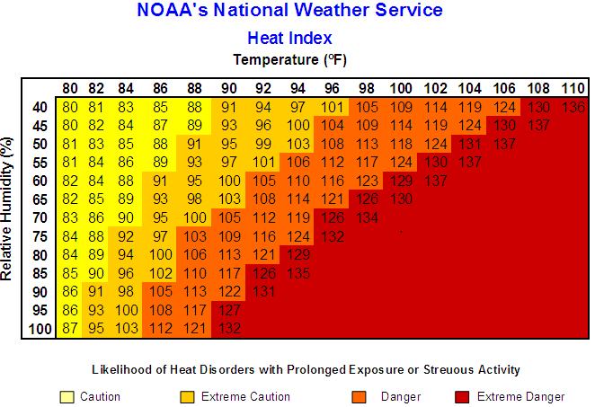

Slide 8
Recognition of Cold-Related Injuries
Monitor closely and initiate gradual re-warming if any of these signs or symptoms are present:
Dry, waxy skin, edema, burning or tingling sensation, skin is white, gray, black or purple, blood blistering, itching skin, loss of sensation, increased temperature.
Vigorous shivering, pallor, nose bleeds.
Seek medical attention if any of these signs or symptoms are present:
Amnesia, depressed respiration, slurred speech, impaired mental function, dilated pupils, muscle rigidity, coma.

Slide 9
Prevention of cold-related injuries
Perform thorough pre-participation screening to ID those more predisposed or have previous history.
Have medical care on site that are familiar with cold related injuries.
Educate athletes on prevention, recognition, treatment, and risks involved.
Encourage proper sleeping, nutrition, and rest breaks to athletes.
Develop event and practice guidelines for participating in cold conditions using wind chill factors.
Proper dress: Internal layer evaporates but not absorbs sweat, the middle layer insulates and the external layer should be water and wind resistant.
Provide athletes opportunities to rewarm or stay warm throughout practice/competition. Include warming supplies: water and rehydration, heat packs, blankets, heaters, and a warm tub if possible.

Slide 10
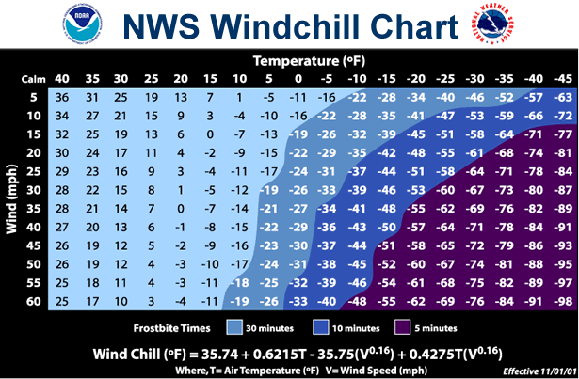
30˚ and below: Be aware of potential for cold injury 25˚ and below: provide additional clothing, cover as much as possible and facilitate rewarming. 15˚ and below: consider modifying activity to limit exposure 0˚ and below: Consider terminating or rescheduling activity

Slide 11
References
Heat illnesses: National Athletic Trainers’ Association Position Statement: Exertional Heat Illnesses (2002). http://www.nata.org/sites/default/files/ExternalHeatIllnesses.pdf
Acclimatization: National Athletic Trainers’ Association consensus statement (2009) http://www.nata.org/sites/default/files/NATA09AnnualMeetingLeadRelease.pdf
Heat Index: National Weather Service. http://www.nws.noaa.gov/os/heat/index.shtml#heatindex
Cold: National Athletic Trainers’ Association Position Statement: Environmental Cold Injuries (2008). http://www.nata.org/NR120208
Windchill: National Weather Service. Accessed through: http://www.nws.noaa.gov/om/windchill
Also used: NCAA Sports Medicine Handbook 2011-2012

